Slide 1

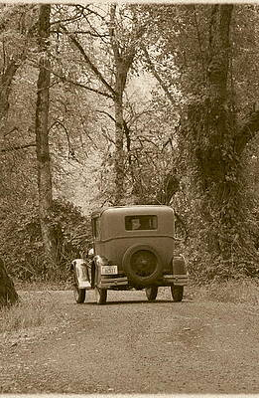
FUSION
Lidar processing and visualization software
Bob McGaughey
USDA Forest Service
Pacific Northwest Research Station
Vegetation Monitoring and Remote Sensing Team

Slide 2
Overview
FUSION history & overview
Basic tools
Workflow tools
Future

Slide 3
Initial LIDAR team (1998-1999)
Steve Reutebuch & Bob McGaughey
  USDA Forest Service, Pacific Northwest Research Station
  Steve retired in February 2016
Hans-Erik Andersen
  Then: University of Washington
  Now: USDA Forest Service, Pacific Northwest Research Station

Slide 4
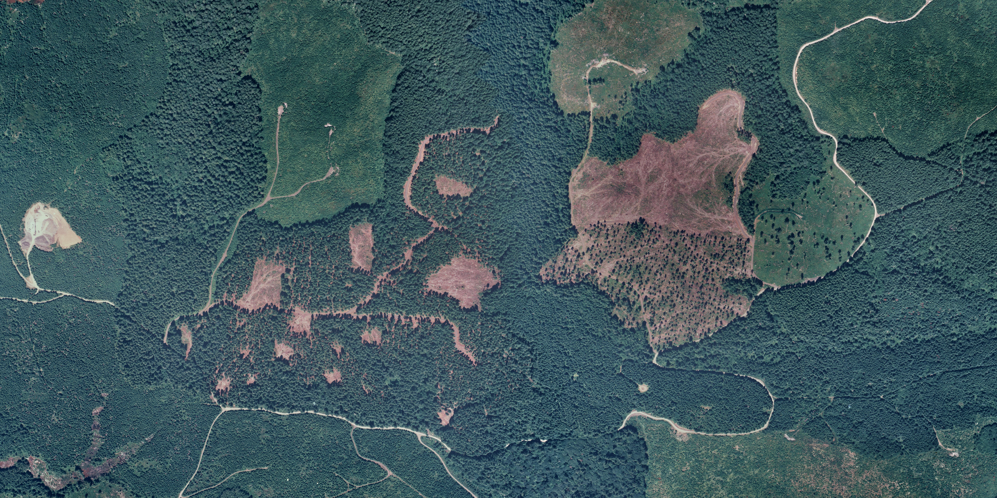
Our first LIDAR project (1998-1999)
Pre- and Post-treatment data acquired by helicopter
  ~800 ha
  SAAB TopEye scanner
  7000 pulses/second
  4-6 pulses/m²
  40 million points
  Delivered in ASCII text
Hypothesis was that you could NOT get adequate measurements of the ground surface under dense, Douglas-fir canopies typical in western Washington and Oregon
  We were wrong…

Slide 5
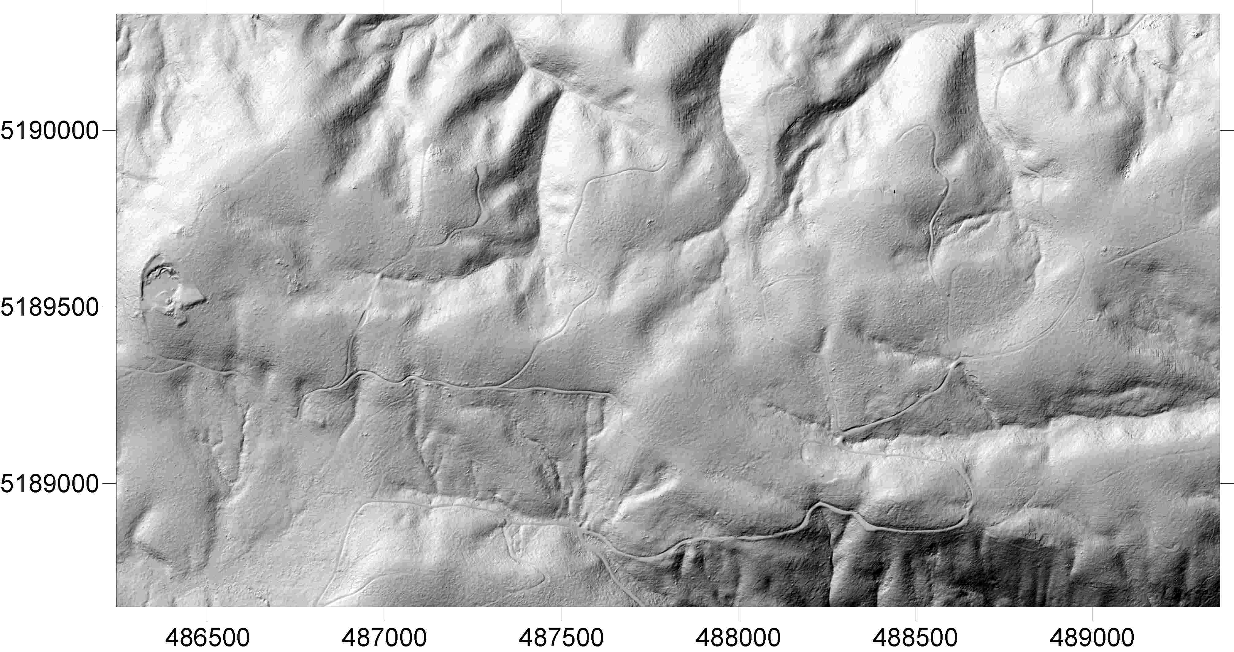
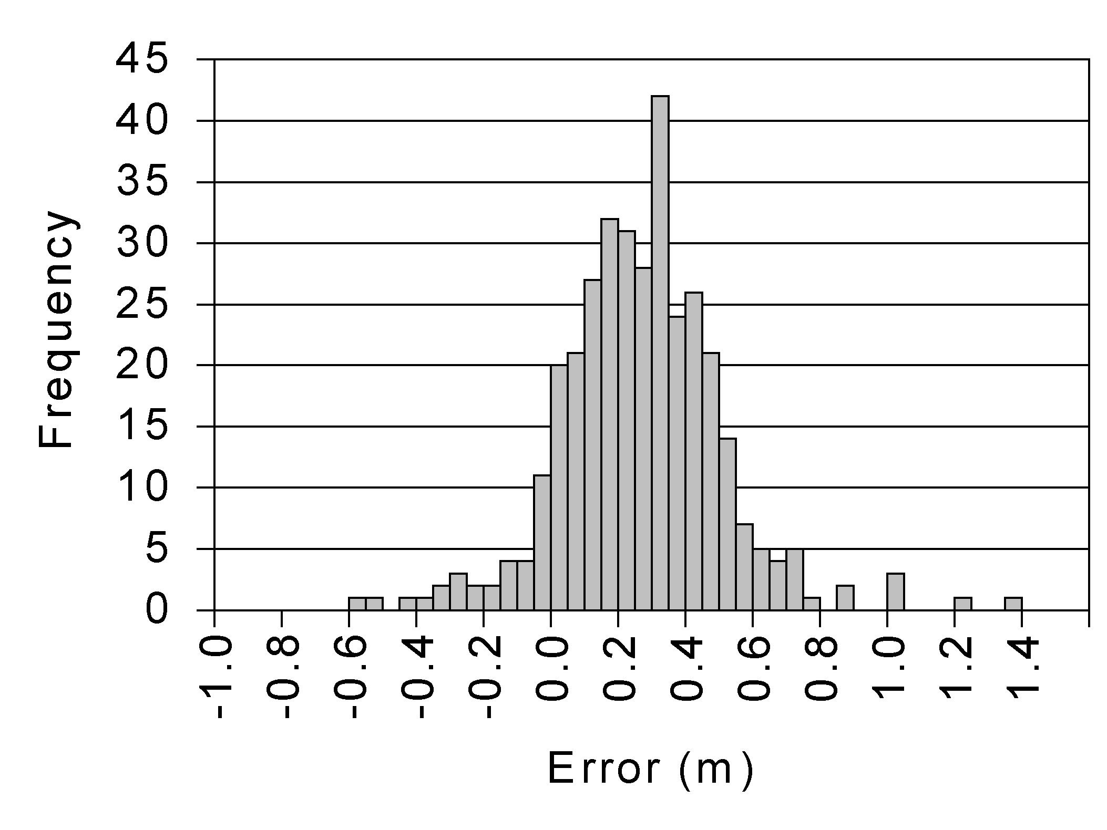
Bare-earth accuracy
Mean LIDAR DEM error compared to 350 survey points
  22 cm…9-inch field boot height!
Maximum errors:
  +1.31 meter, -0.63 meter
    +4.3 ft, -2.1 ft
Error was generally not affected by canopy density
LIDAR DEM

Slide 6
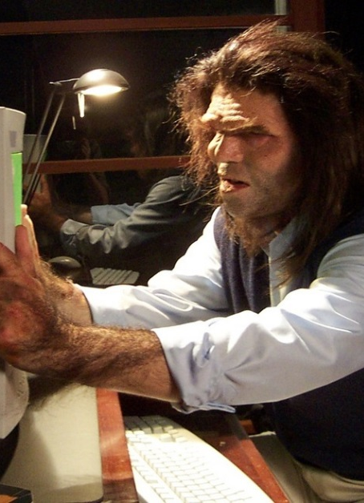
Our first LIDAR tools
Original dataset was 40 million points (all returns)
  We had to split the area into 4 tiles just to create a 1m gridded bare-earth surface
  Most software at the time (1999-2000) couldn’t handle the data
Our earliest software tools were designed for specific tasks (FORTRAN, C, C++, and IDL)
Visualization was essential to help us understand the data

Slide 7

FUSION was born
We needed software tools to help us understand what was being measured by LIDAR…and what was not
As we learned more, the tools became more general and more flexible
In 2003-2004, we started working on a unified set of LIDAR tools that would support a variety of analysis tasks

Slide 8

FUSION goes public
First public release in 2006
LAS support but most projects still delivered in ASCII text format
Support and training through the Forest Service’s Remote Sensing Applications Center (RSAC…now GTAC)
  Written and online tutorials
  Hands-on training

Slide 9
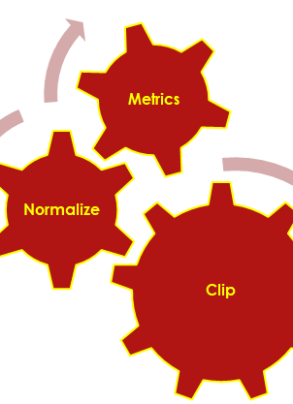
Overall design
Focuses on applications in a forestry context
Programs (50+) are designed to accomplish specific tasks
Programs serve as building blocks for complex analyses
Point data are almost always subdivided so they can be loaded into memory—a few tools stream point data
Most point tools can clip rectangular areas and normalize using ground surfaces on-the-fly
Notes:
Last 2 points are important: the size of the delivery tiles doesn’t really matter. We are starting to see more acquisitions with very large delivery tiles (1Gb +)

Slide 10
Data exploration and visualization
FUSION
Data
interface
LDV
Data
viewer
Sample options
  Shape & size
  Coloring rules
  Snap to POI
Tree data
Canopy model
Image
Bare-earth model
Color
Motion
LIDAR data
Hotspots
Lighting
Glyph
Points of interest (POI)
Measurement
PDQ
Simple Data
viewer
Command line processing and utility programs
AreaProcessor
Notes:
PDQ provides 3D viewing and manipulation for LAS, FUSION, ASCII LIDAR data and FUSION surface models

Slide 11
Demo FUSION & LDV

Slide 12

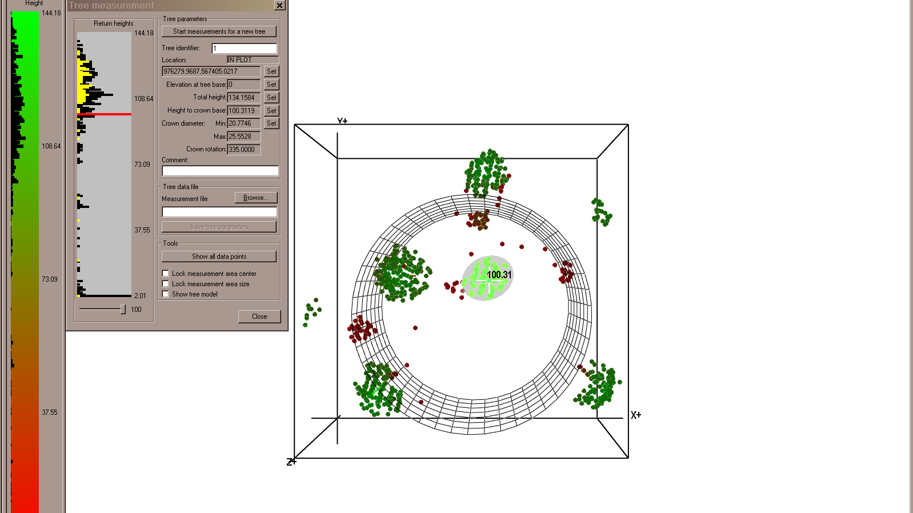




Slide 13
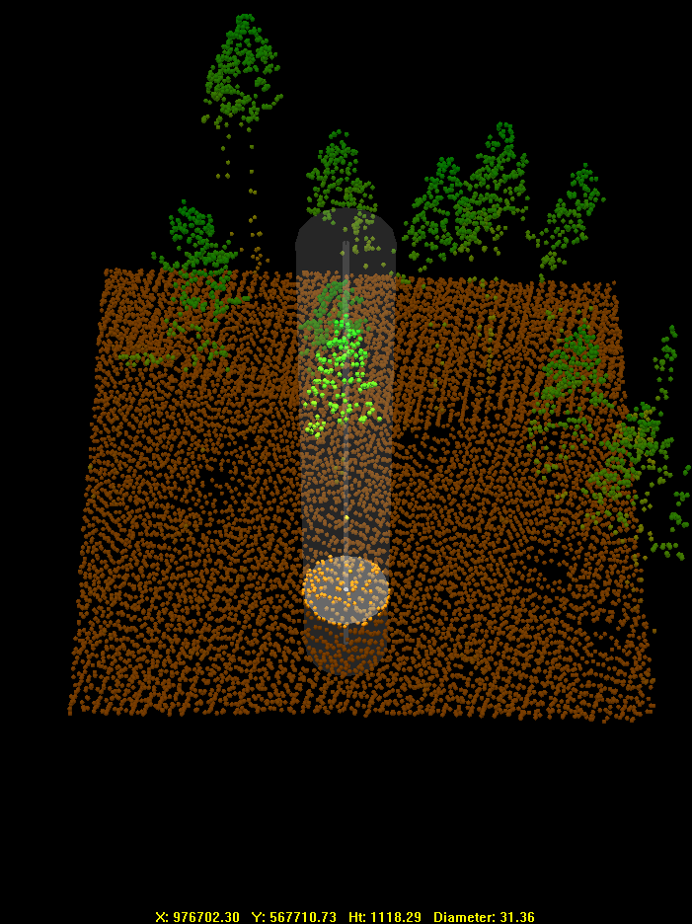
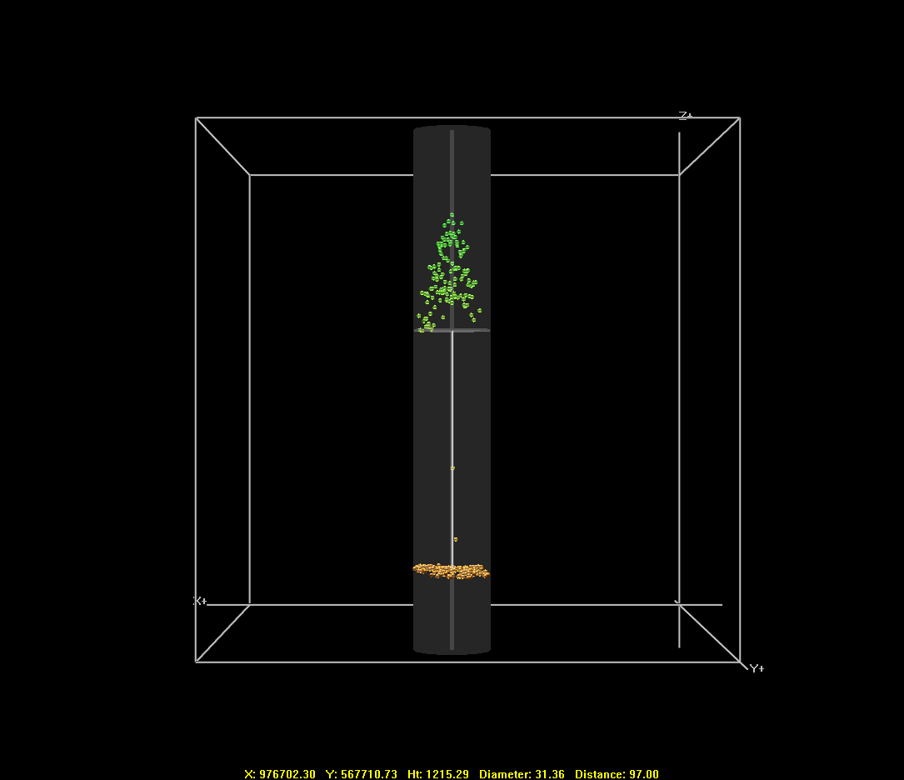
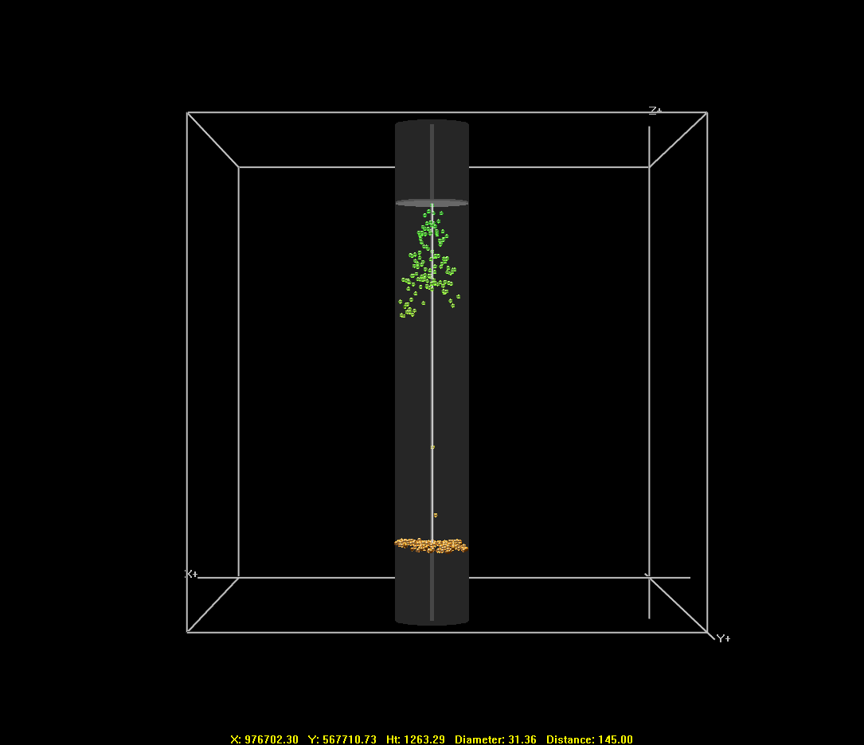
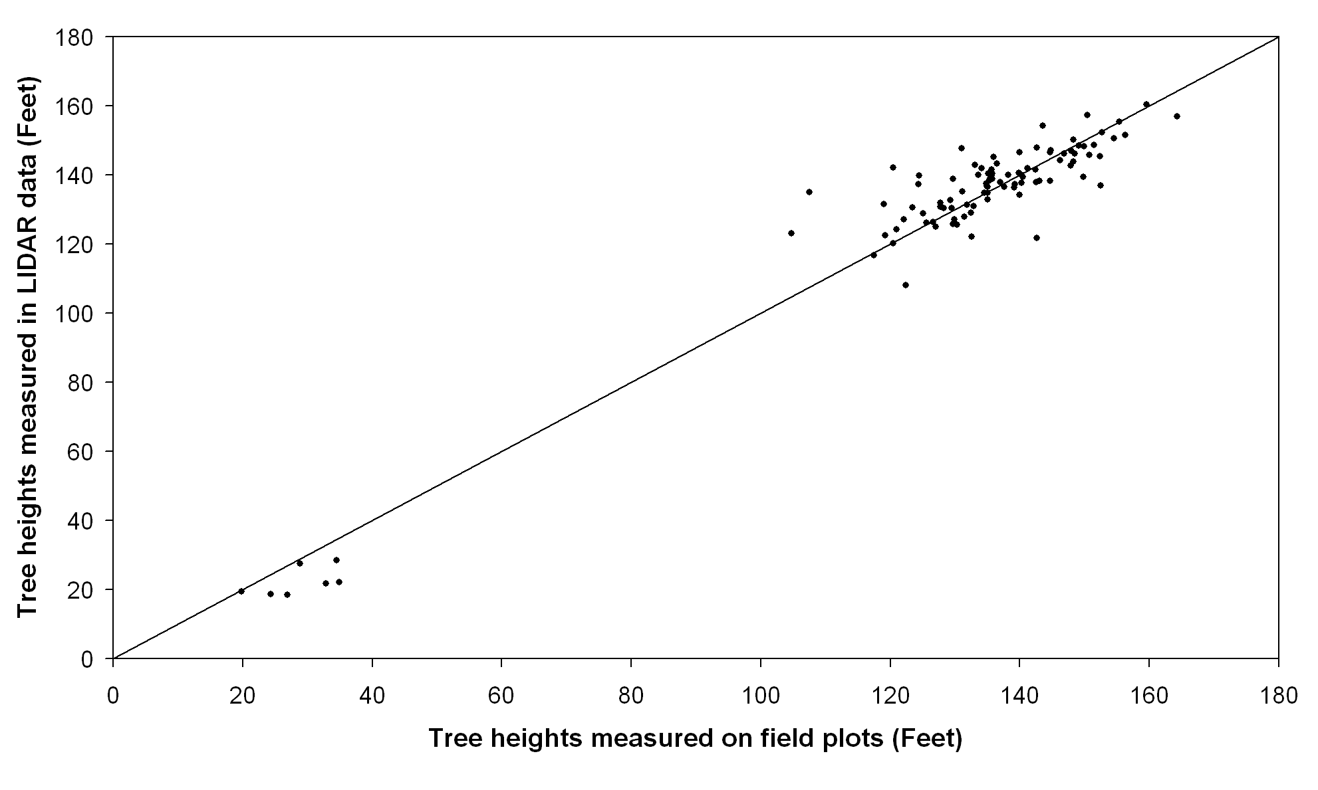
Measuring tree attributes
Notes:
Hidden for presentations that include a live demo of FUSION and LDV software

Slide 14
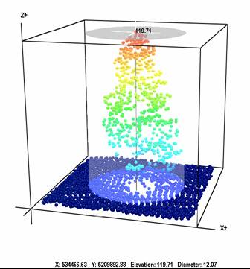
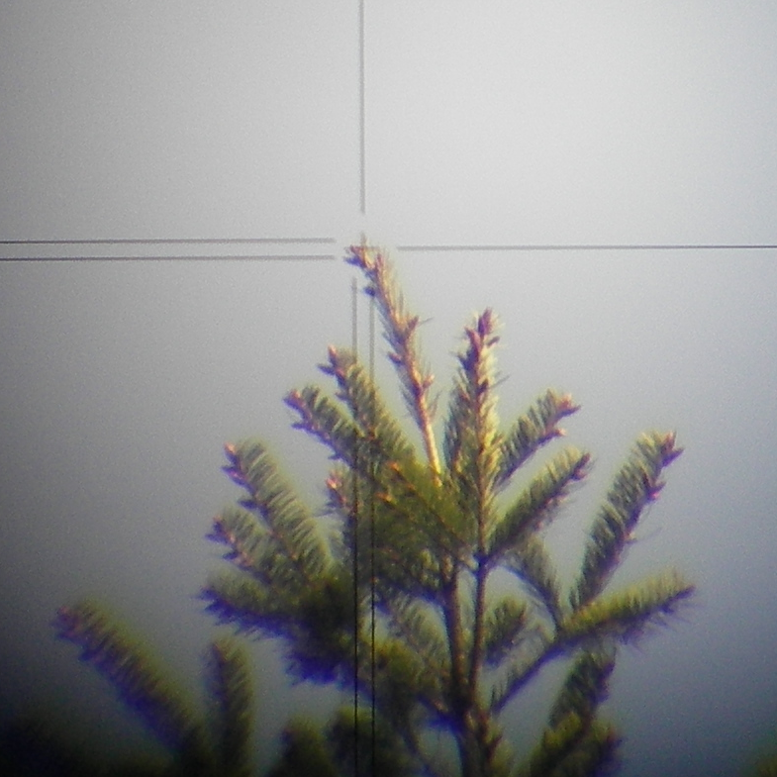
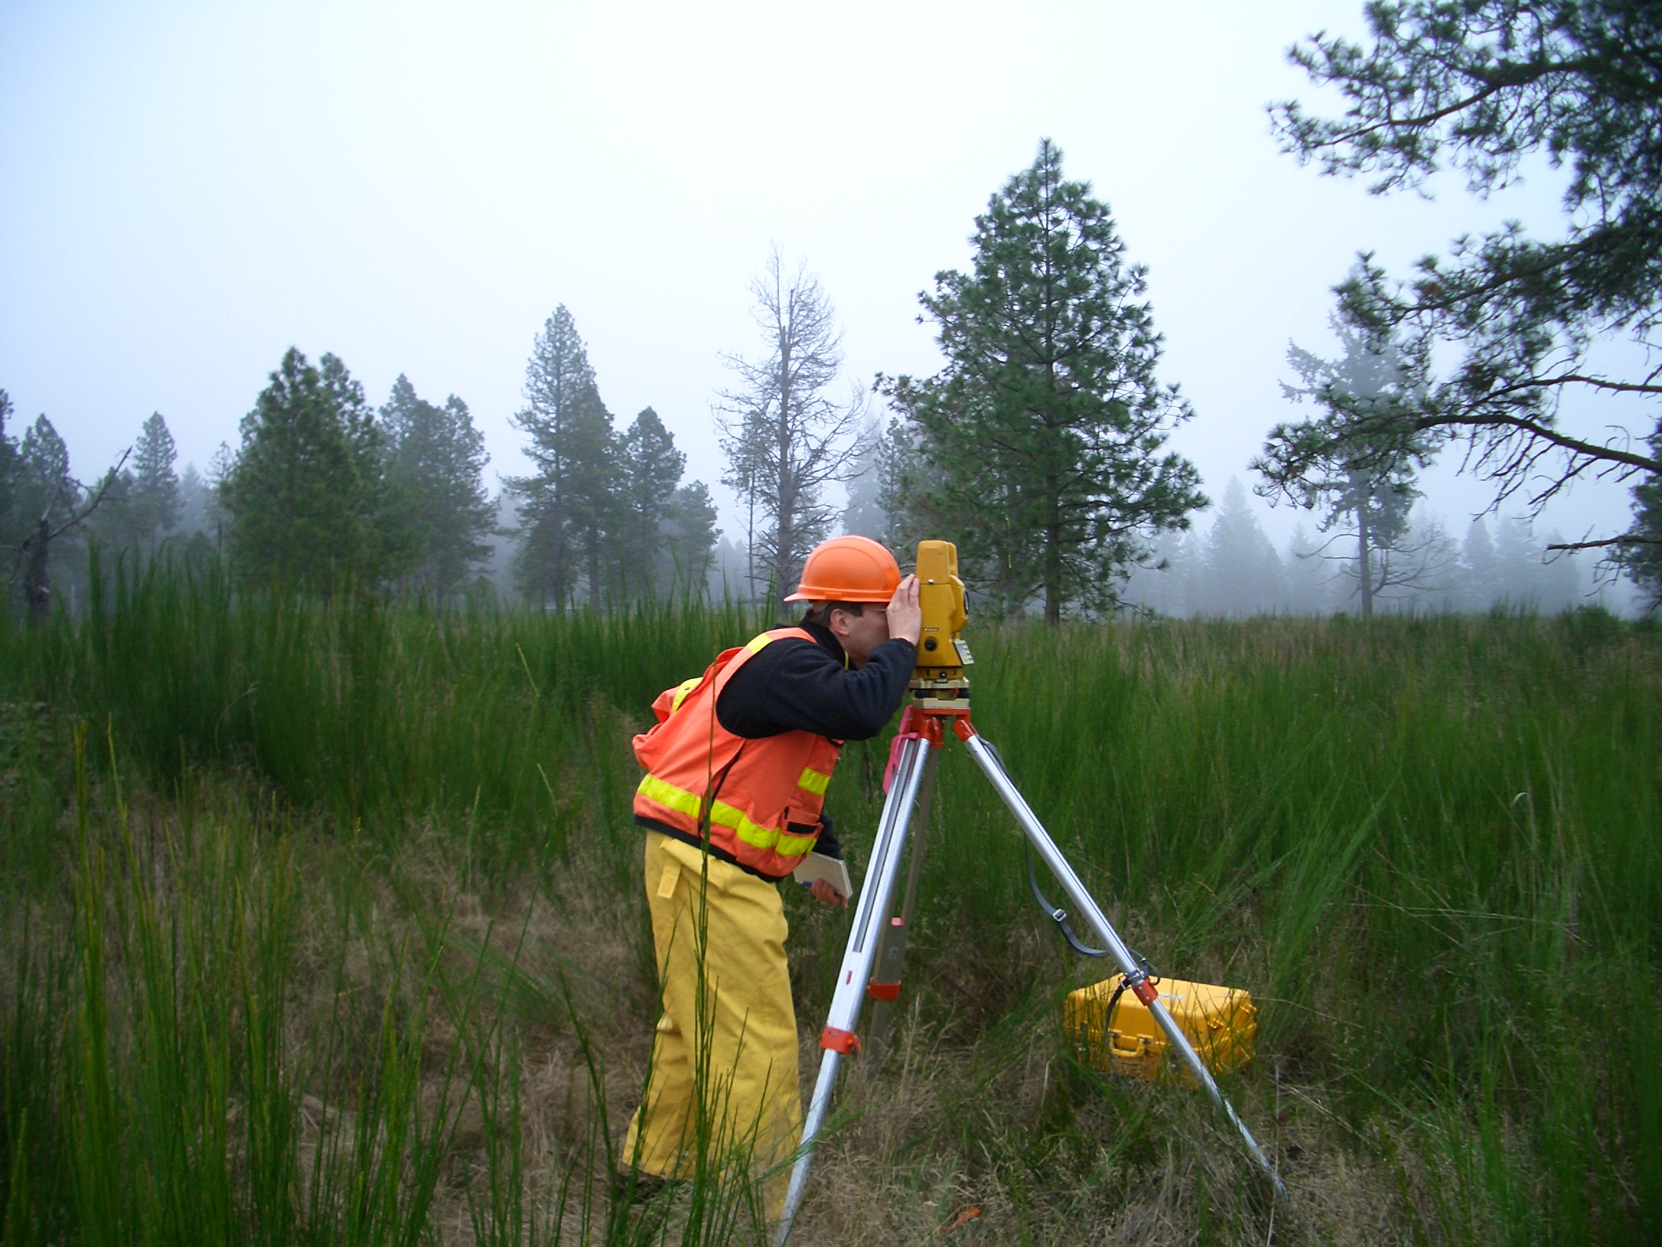
Individual tree heights
Study carried out in Fort Lewis Military Reservation, WA
Accurate tree height measurements obtained using surveying instruments (total station) & least squares adjustment
Average error of tree top measurements from survey: 2 cm!
Lidar tree hts. measured in FUSION software

Slide 15
Individual tree heights
Tree heights from narrow beam LIDAR (-0.73 ± 0.43 m) more accurate than wide beam (-1.12 ± 0.56 m)
LIDAR heights for Ponderosa pine (-0.43 ± 0.13 m) more accurate than for Douglas-fir (-1.05 ± 0.41 m)
Heights from conventional field techniques (-0.27 ± 0.27 m) are more accurate than heights from LIDAR (-0.73 ± 0.43 m)
Notes:
Source: Andersen et al., Can. J. of Remote Sensing, In review.

Slide 16
Pulse density and tree heights

Slide 17

Command-line toolkit
Point Cloud tools
  Clipping (circle, rectangle, and polygon) & merging
  Thinning
  Filtering (ground and outlier)
  Compute metrics
Surface tools
  Grid and TIN creation
  Clipping & merging
  Compute metrics (CHM and topo)
Conversion tools
  To/from various formats
  Mostly from FUSION-specific formats to ASCII raster then rely on GDAL for other formats
Miscellaneous
  Intensity images
  Tree segmentation (watershed & local maxima)
  QA tools

Slide 18
Forestry applications
Direct use of surface and point data
  Hydrology, topographic metrics, microclimate conditions
  Vegetation height (CHM – ground)
  Presence/absence of trees (large trees)
  Canopy cover (proportion of 1st returns above height threshold)
Derived products
  Area-based approaches for inventory
  Clump/gap analyses
  Forest structure
  Individual tree

Slide 19
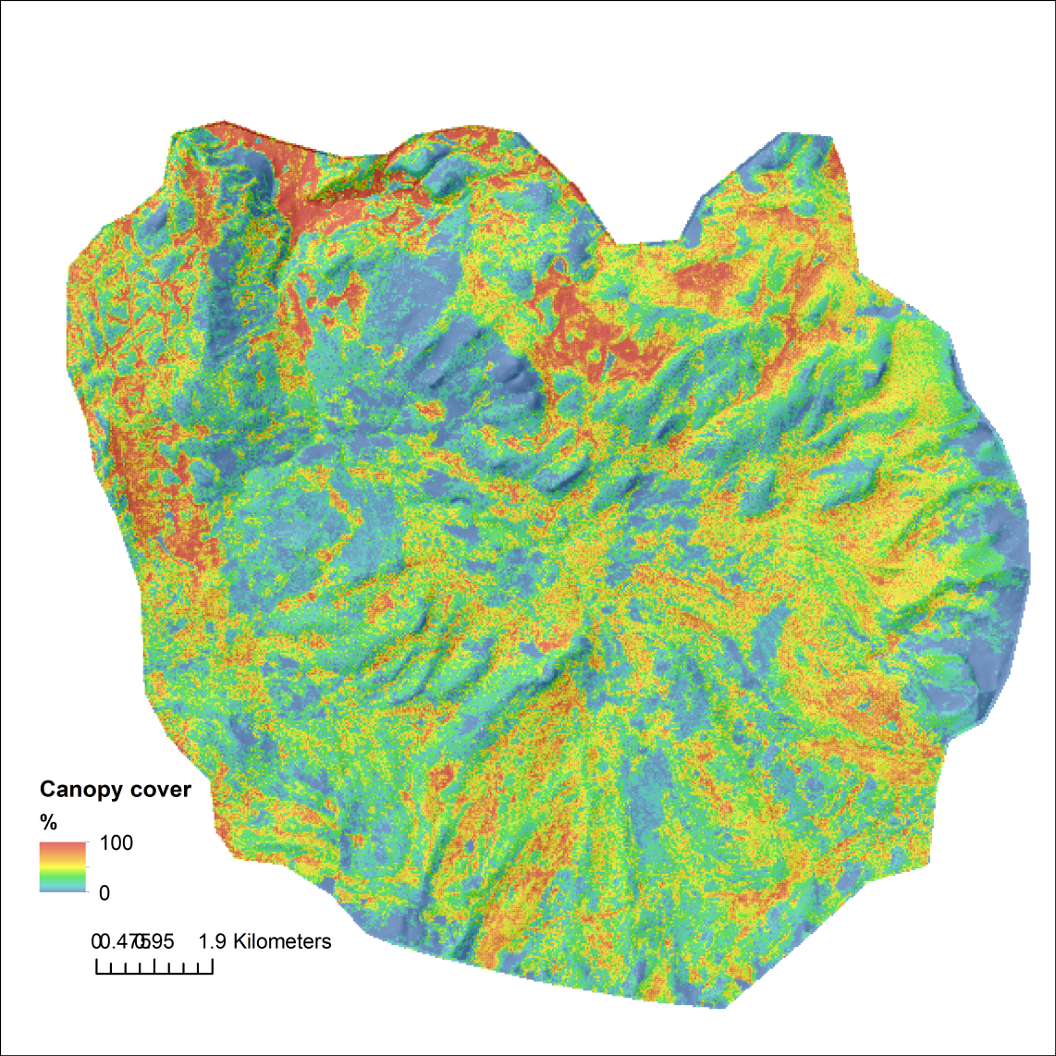
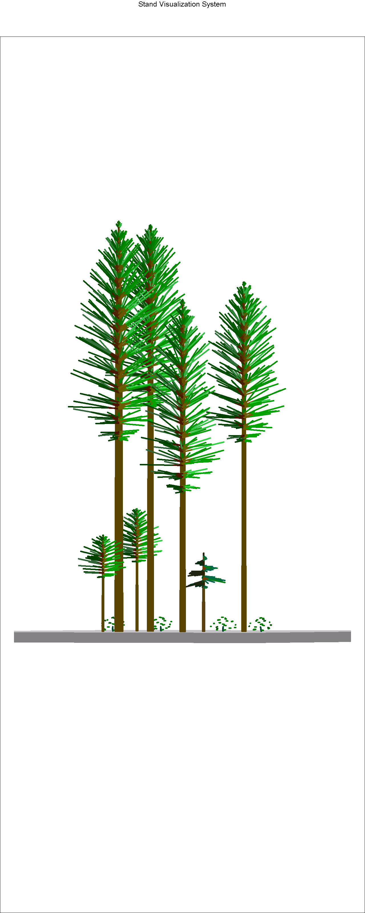
Canopy cover
# first returns in canopy (13)
Total # first returns (20)
=
65%

Slide 20
Area-based approach (ABA) for modeling
Relies on field measurements and lidar collected during the same growing season (ideally)
Relate lidar-derived metrics to summarized field attributes by developing statistical models
Apply model to lidar-derived metrics covering entire acquisition to map attributes over large areas

Slide 21
ABA steps
Given a set of field plots with accurate locations:
  Clip point data corresponding to the plot area
  Normalize point elevations using ground surface
  Compute metrics using normalized points
  Fit model(s) to related lidar-derived metrics to field attributes
  Compute metrics over entire acquisition area using cell size that matches the plot size
  Apply the model(s) to map attributes

Slide 22
ABA steps
Given a set of field plots with accurate locations:
  Clip point data corresponding to the plot area
  Normalize point elevations using ground surface
  Compute metrics using normalized points
  Fit model(s) to related lidar-derived metrics to field attributes
  Compute metrics over entire acquisition area using cell size that matches the plot size
  Apply the model(s) to map attributes

Slide 23
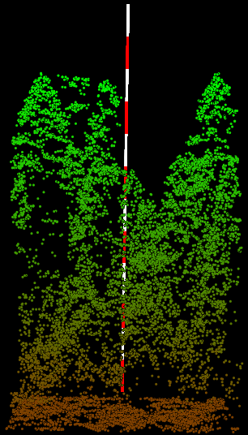
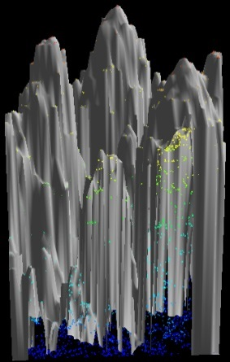
Metrics used for structure classes
Dominant tree height -
95th percentile*
Canopy profile**
Cover >32 m
Cover 16-32 m
Dominant lower foliage height -
25th percentile*
Structural complexity –
rumple (rugosity)
Cover 8-16 m
Cover 2-8 m
*Returns ≥2 m

Slide 24
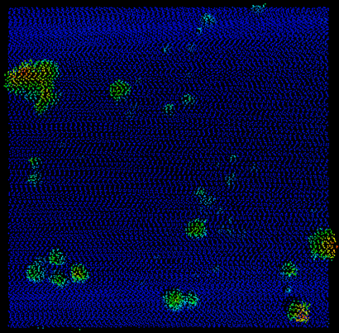
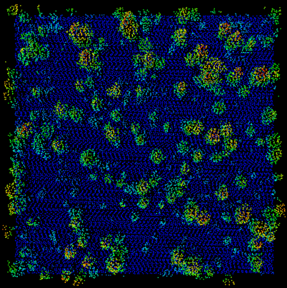
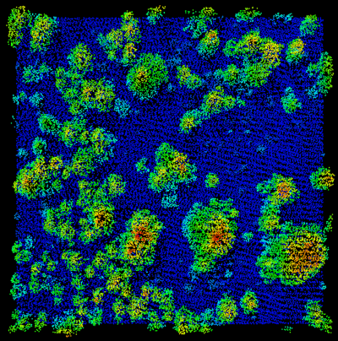
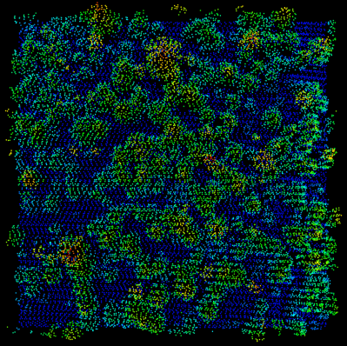
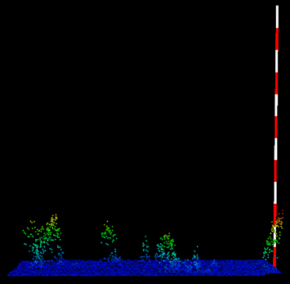
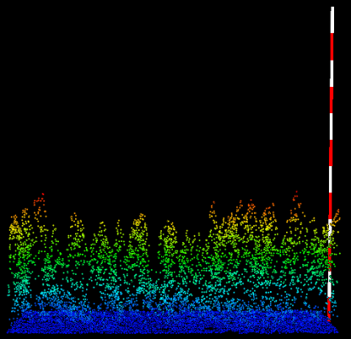
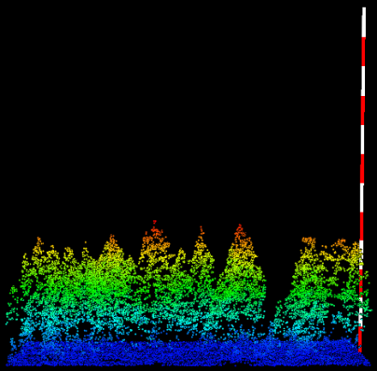
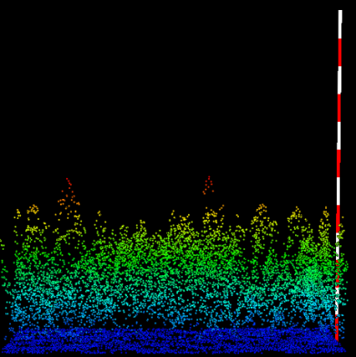
Structure classes
Class 1
Short
Open
p95*=20m cvr >2m=16%
Class 2
Shorter
Multi-story
Sparse
p95*=20m cvr >2m=34%
Class 3
Shorter
Multi-story
Sparse
p95*=20m cvr>2=44%
Class 4
Shorter
Multi-story
Clump-gap
p95*=22m cvr>2=62%
*median class values

Slide 25
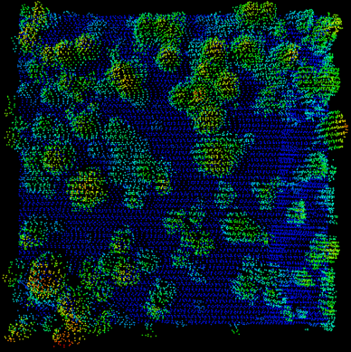
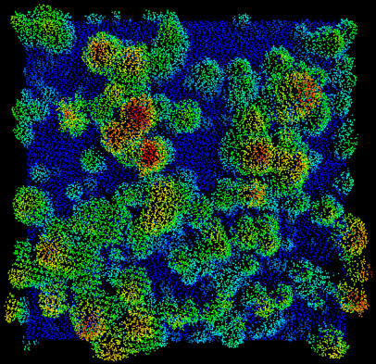
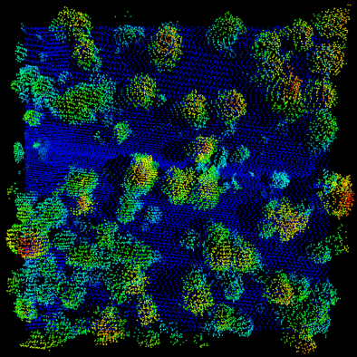
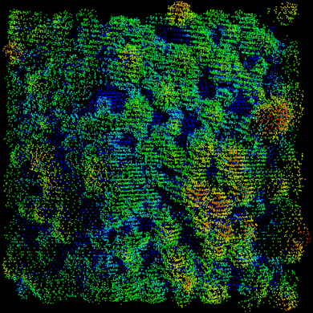
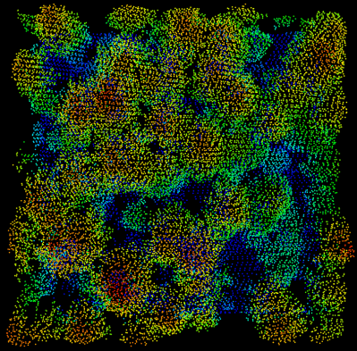
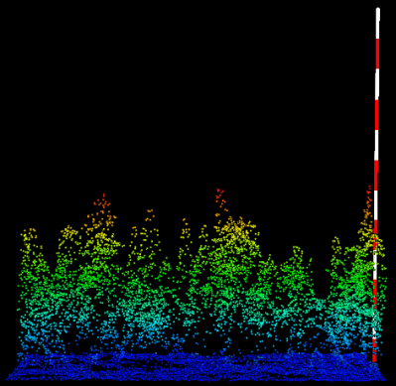
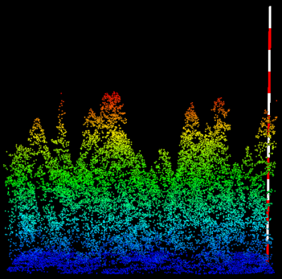
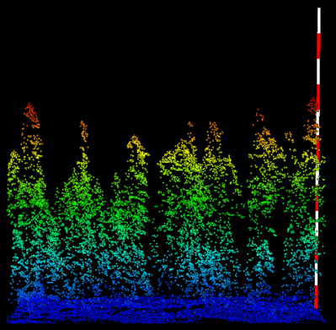
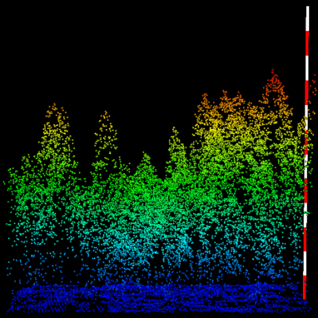
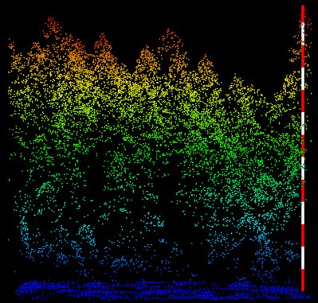
Structure classes
Class 5
Mid-height Mult-story
Clump-opening
p95*=26m cvr>2=51%
Class 6
Mid-height Mult-story
Clump-gap
p95*=29m cvr>2=69%
Class 7
Taller
Topstory
Clump-opening
p95*=32m cvr>2=49%
Class 8
Taller
Topstory
Clump-gap
p95*= 34m cvr>2=69%
Class 9
Tallest
Topstory
Clump-gap
p95*=45m cvr>2=71%
*median class values

Slide 26
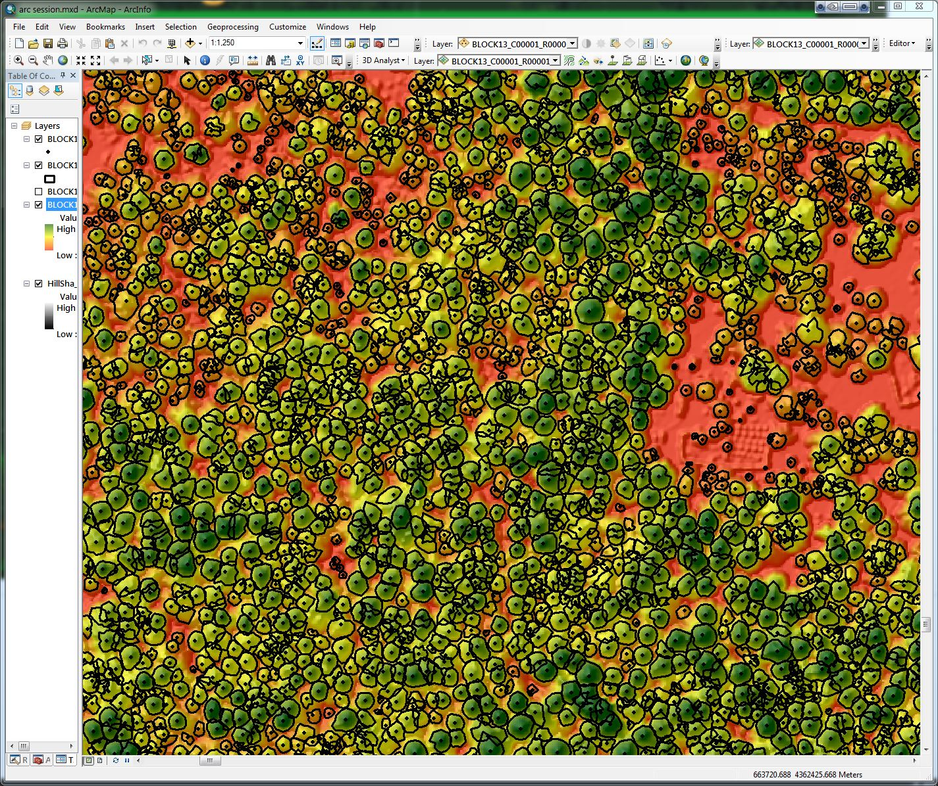
Individual trees
Detect trees using CHM
Add point cloud metrics for each tree
Use as individual trees
Aggregate over areas and summarize

Slide 27
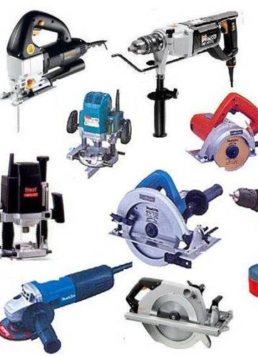
Workflow tools
Workflow generator—AreaProcessor (AP)
Terminology
  Delivery tiles: Point tiles (LAS or LAZ) delivered by the data provider
  Processing tile: Set of points submitted to all of the tools. Typically these are clipped from the delivery tiles and include a “buffer” around the tile.
  Processing block: Collection of processing tiles that will be processed by a single processing thread. Processing blocks also provide a structure for outputs.

Slide 28
AP workflow
Workflows can support a variety of processing tasks
  Standard scripts included with the distribution produce a variety of outputs
  Outputs can be turned ON or OFF
  Savvy users can use the workflow in non-standard ways or with non-FUSION tools
Single or multiple processing threads
Always a single-entry point to start the processing
Separate monitoring tool provides visual display of progress

Slide 29
AP workflow
Configuration
GUI interface
Batch file
Processing runs on several cores/threads
For each processing tile:
Clip
Process
Check for errors
User-defined processing steps
Extract & merge
Notes:
In the scripts provided with the AP distribution, the setup batch file turns various products on/off and sets options to control merging of products, cell sizes, and ground surface options. The configuration parameters specified in the GUI are more general and serve to identify the overall run.

Slide 30
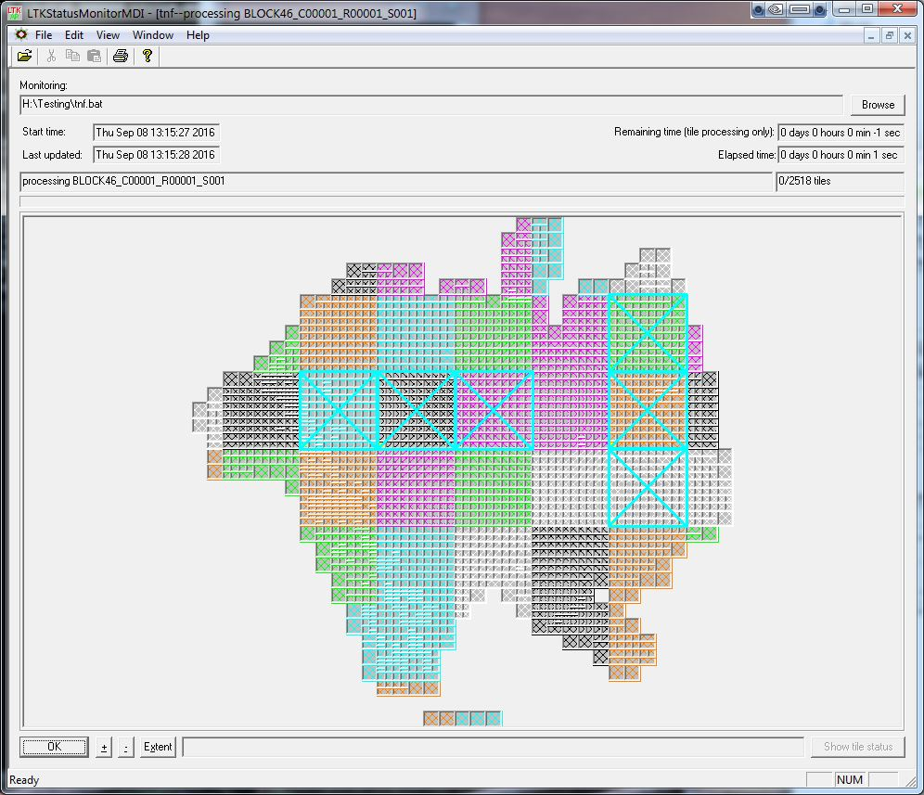
Progress monitoring
Colors represent cores/threads
Smallest areas are processing tiles
Larger areas (colored) are processing blocks

Slide 31
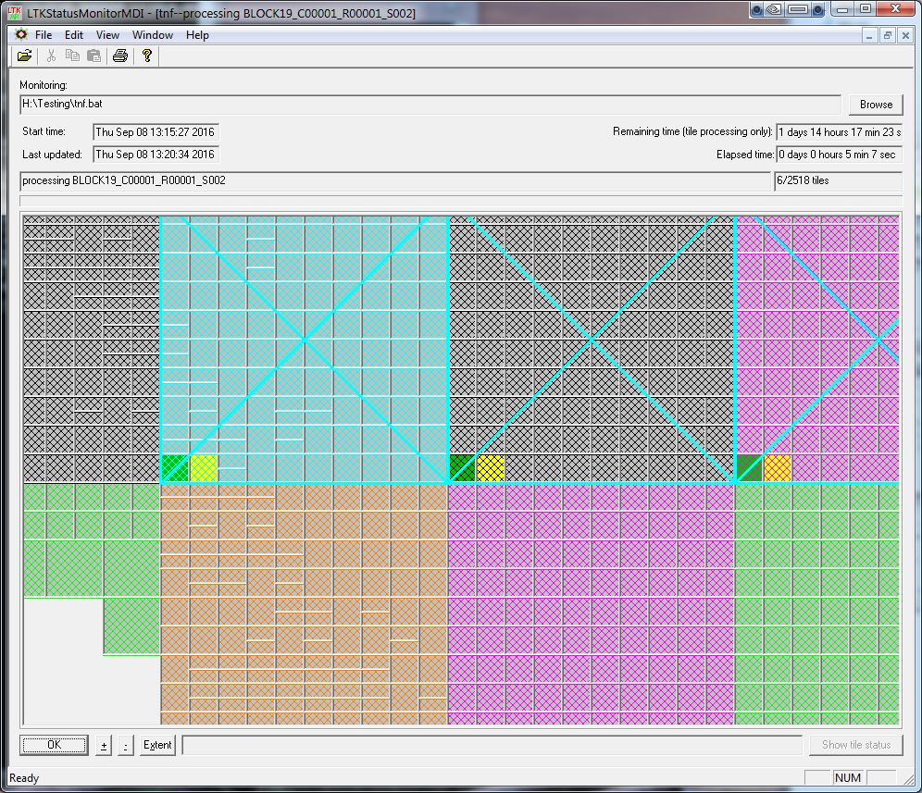
Progress monitoring
Green is good
Yellow is in-process
Red indicates errors

Slide 32
Products
Standard set of outputs produced using scripts distributed with FUSION
Raster data in ERDAS IMAGINE format (200+ layers)
  First-return metrics (elevation and intensity)
  All-return metrics (elevation and intensity)
  Metrics by height strata (all and first returns in 11 strata)
  Canopy height models
  Canopy height surface metrics
  Intensity images
  Bare-ground surface models (optional)
  Topographic metrics
Shapefiles for delivery tiles, ground models, processing tiles & processing blocks

Slide 33
Where is FUSION used?
Users across the U.S and several other countries.
  I usually only hear about new users when something goes wrong or someone wants to do something “unusual” with their data
Training
  RSAC has trained over 2000 people through 1-3 day training sessions
  Workshops covering FUSION presented in Mexico, Brazil, & Philippines
Web tracking active from 2013-2016 showed 400-600 downloads/month
Forest Service western regions have active lidar programs and use FUSION for quality assessments and to produce product sets
  I know less about eastern regions but know there is lidar activity and FUSION use
University teaching and research (international)

Slide 34
Future?
Past…
  FUSION & data viewers are built on Windows GUI
  Command line tools rely on Microsoft Foundation Classes
  Source code has always been available but not “advertised”
  Releases prior to 2020 were built using MS VC6
Future…
  Ideally code will move onto github
  Tested with 2 programs (with help from Howard Butler)
    Build actions work for windows platform
  Movement to any other platform is unlikely

Slide 35
Download link
  http://forsys.sefs.uw.edu/fusion/fusionlatest.html
Tutorials
  Search (google) for “RSAC lidar”
  https://www.fs.fed.us/eng/rsac/lidar_training/
Manual (included in download)
  http://forsys.sefs.uw.edu/software/fusion/FUSION_manual.pdf

