Slide 1
Comparing digital aerial photogrammetry (DAP) and lidar data to assess vegetation conditions
Bob McGaughey

Slide 2
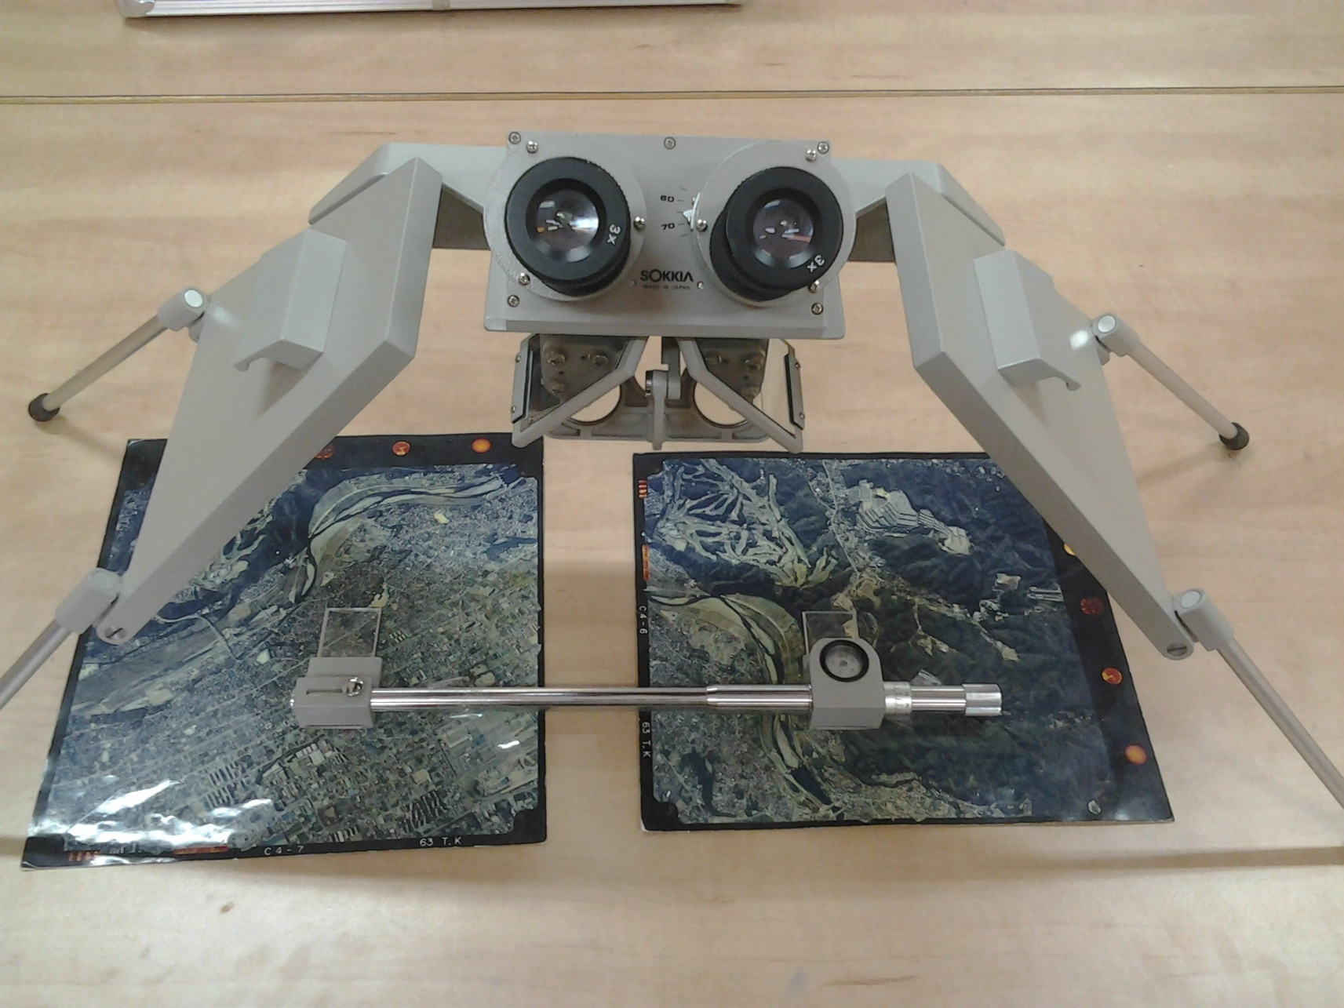
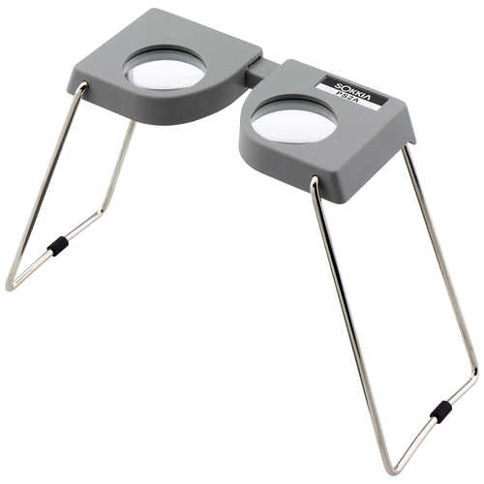
In the beginning…

Slide 3
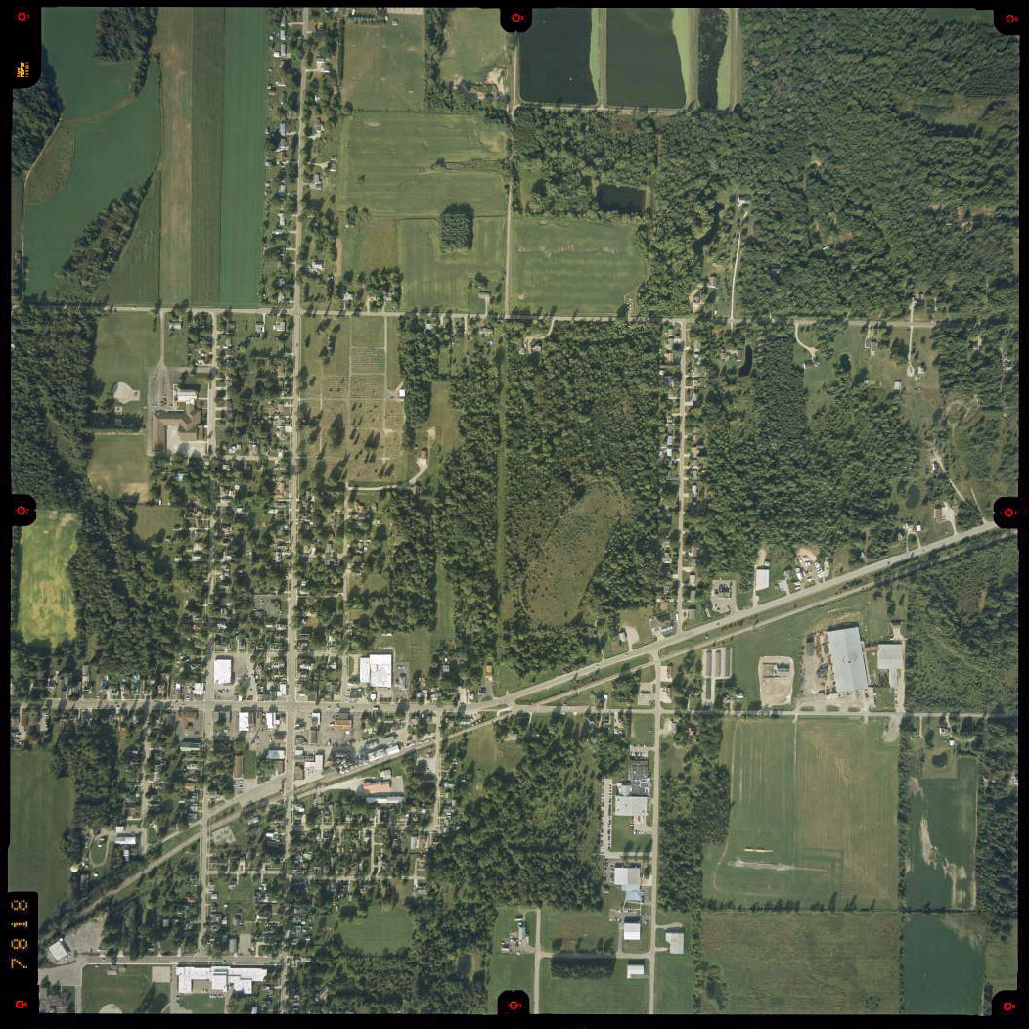
Aerial photo

Slide 4
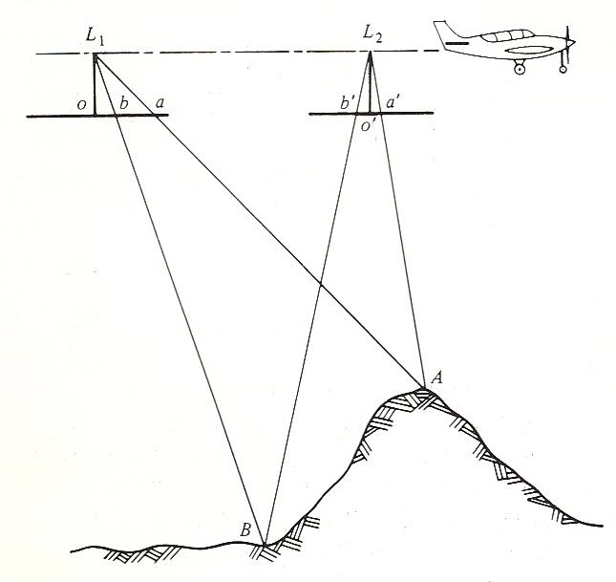
Basic photogrammetry
Photogrammetry relies on multiple views of the same point on the ground from two or more observation points (aircraft positions).
Parallax is the apparent displacement in the position of an object, with respect to a frame of reference, caused by a shift in the position of observation. (Wolf 1974)

Slide 5
Basic photogrammetry
Objects closer to the position of observation (aerial camera, eyes) have greater parallax than objects further away.
You can use parallax differences between images to determine the distance to various objects.
If you know the position of the observation point (aircraft), you can produce XYZ measurements for objects in the photo.

Slide 6
Orthophotos
Orthophotos combine the advantages of a map (e.g. constant scale, orthographic projection) with those of a photo (realism and level of detail)
You can measure areas and distances directly on an orthophoto (you can’t on aerial photos)

Slide 7
Orthophotos
Images that have been orthorectified…
  Remove geometric errors caused by:
    Camera/sensor orientation
    Distortions due to optics
    Relief displacement (elevation or object height)
    Earth curvature

Slide 8


Slide 9

A’
A
Film
Lens
A
B

Slide 10
Orthophotos
Images that have been orthorectified…
  Remove geometric errors caused by:
    Camera/sensor orientation
    Distortions due to optics
    Relief displacement (elevation or object height)
    Earth curvature
  Orthorectification relies on a surface
    Historically a bare-ground surface (USGS 30- or 10-m grid)
    More recently, the “surface” is produced by image matching
      Only required “data” is stereo imagery
      Surface can be bare ground, building edges, roof lines, treetops, etc.

Slide 11
Dense point clouds
By-product of the image matching process used in digital aerial photogrammetry (DAP)
This process operates at pixel or patch scales…each match produces a 3D measurement
3D measurements are used to create a digital surface model (DSM)
  Think of this as a piece of fabric draped over the landscape
  Surface is used to move portions of the original images to remove geometric errors (relief displacement)
Point clouds look similar to LiDAR point clouds but are generally not as detailed and may only represent the upper canopy
Notes:
DAP enabled by:
Digital cameras
GPS and IMU on aircraft so we know the location of every photo
Better algorithms for image matching
Faster computers and graphics processing units (GPU)

Slide 12
NAIP imagery program
National Agriculture Imagery Program administered by USDA Farm Service Agency
New imagery acquired for every state on a two year cycle
All imagery is currently acquired using pushbroom scanners (Leica ALS100)
Standard products are orthophotos…additional derivatives are needed for photogrammetric work
Additional cost for stereo imagery and point cloud is <$10/sq mile (~$1,000,000 for Oregon)

Slide 13
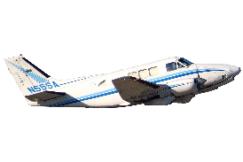
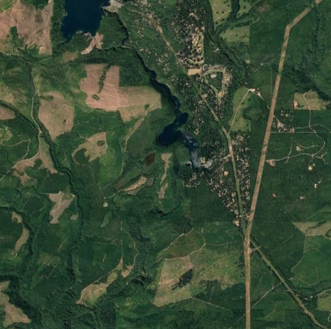
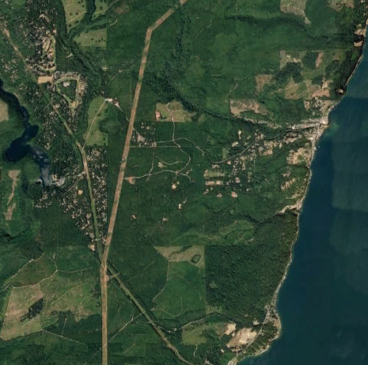
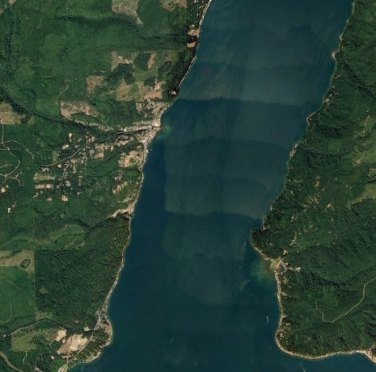
Frame camera

Slide 14
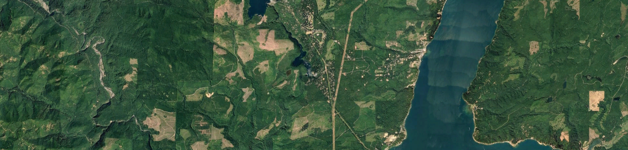
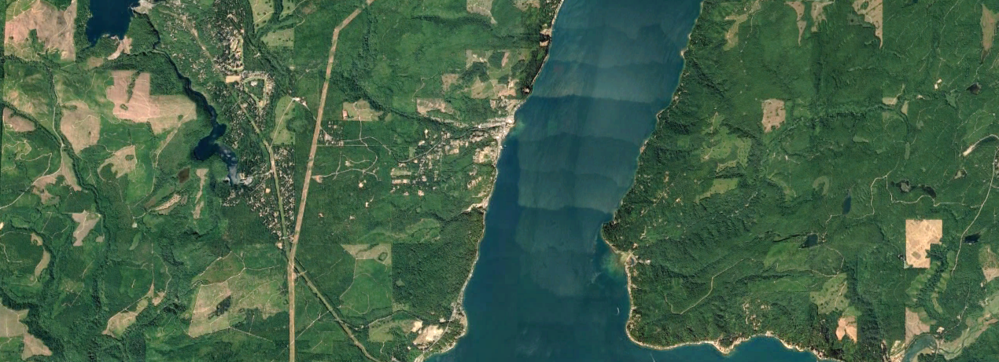
Pushbroom sensor
Direction of flight
-19.4°
Nadir
+25.6°

Slide 15
Direction of flight

Slide 16
“Normal” case for data
Stereo imagery, DSM, and point cloud are “add-on” items to existing NAIP acquisition contracts
Costs are <$10/mi² (in addition to the NAIP cost)
Production process is not necessarily tuned to produce a forestry-friendly product
Statewide coverage in 2018:
  Connecticut, Delaware, Maine, Maryland, Massachusetts, New Hampshire, North Carolina, Rhode Island, Tennessee, Vermont, Virginia, West Virginia
  Oregon is doing 30cm imagery and DAP-derived products in 2018-2019

Slide 17
Best case scenario for data
Washington DNR photogrammetry department
In-house processing of NAIP-derived stereo imagery
Extensive testing and refinement of software parameters to produce DSM and point clouds useful for forestry applications
Imagery collected in 2017 required almost 2 years to process
  200Tb for point data
Commercial vendors can’t really afford to duplicate this process
  Software is expensive and doesn’t scale well
  Documentation of parameters is poor

Slide 18
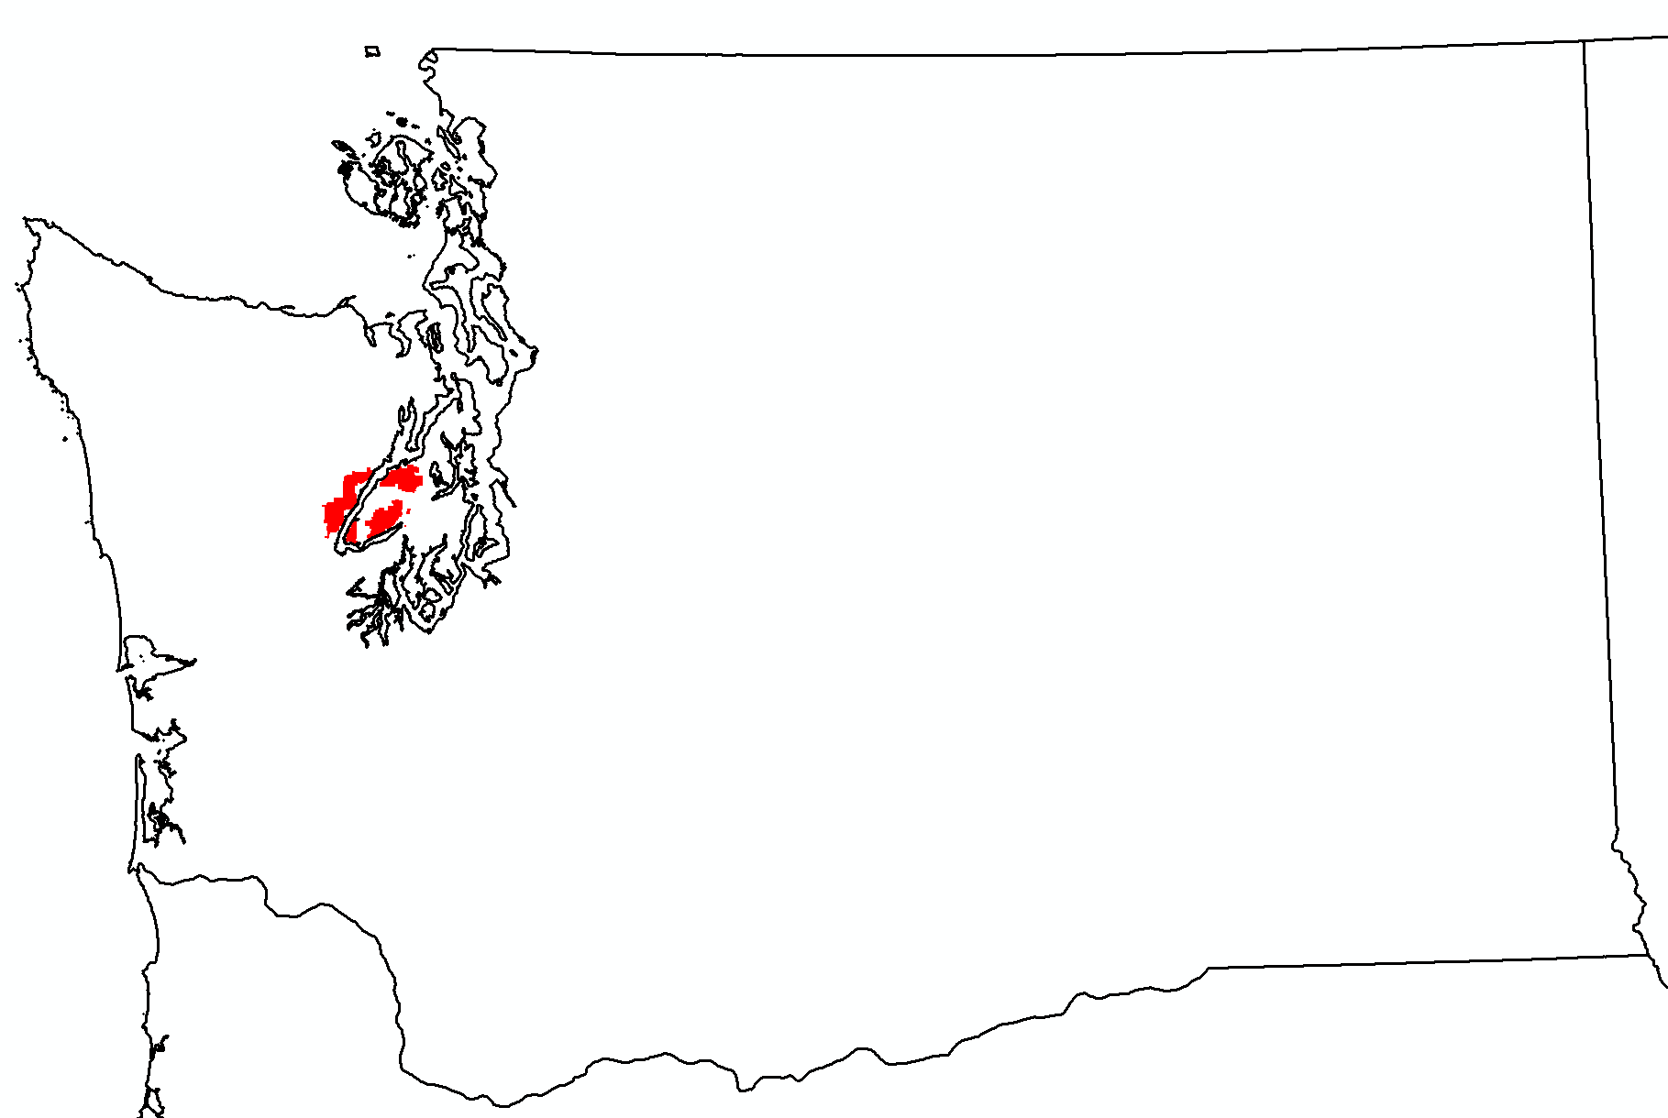
DAP and lidar data
Study site is located near Hood Canal in Washington
90,000 acres for the lidar data
DAP data covers entire state
DAP data clipped to match the lidar coverage
Data density
  DAP point density: 5.6 points.m²
  Lidar pulse density: 13.2 pulses/m² (30.8 points/m²)
  Used first returns for comparison
Ground model from lidar used to normalize DAP & lidar data

Slide 19
Comparisons
Point clouds (visual)
Canopy height model (visual)
Metrics computed from point cloud and canopy surface (quantitative)
Most comparisons done using a set of 3,766 1 ha samples

Slide 20
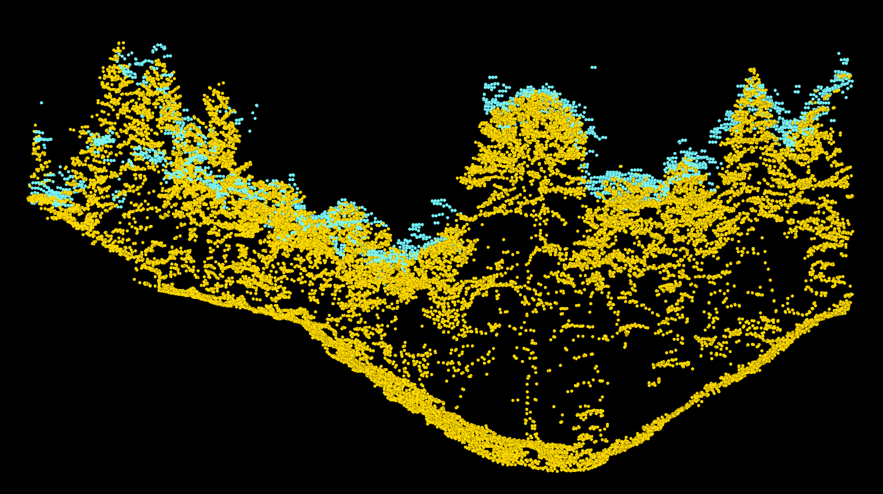
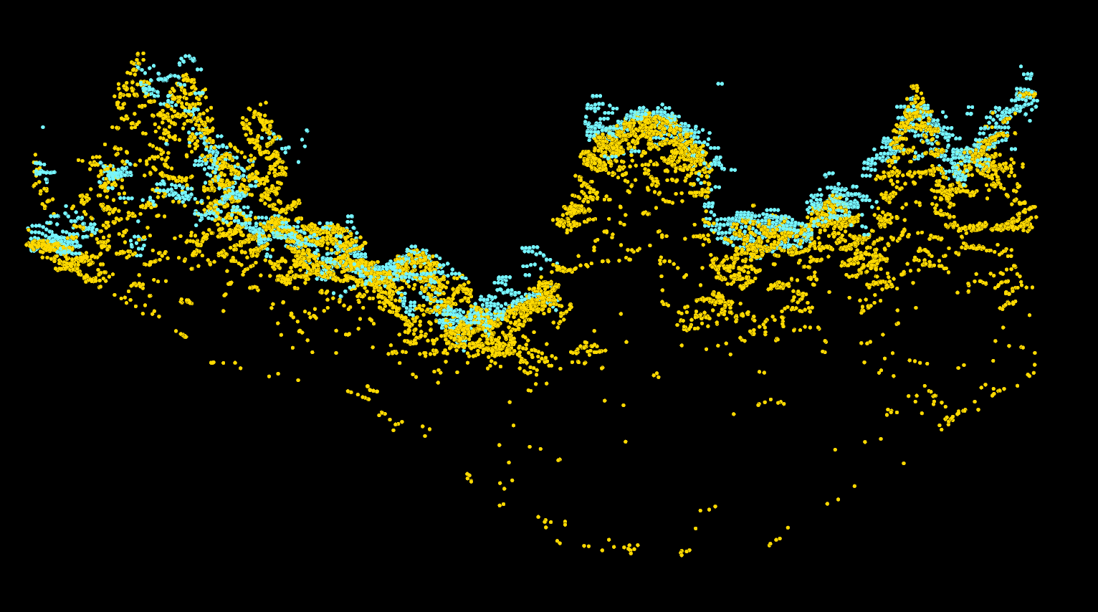
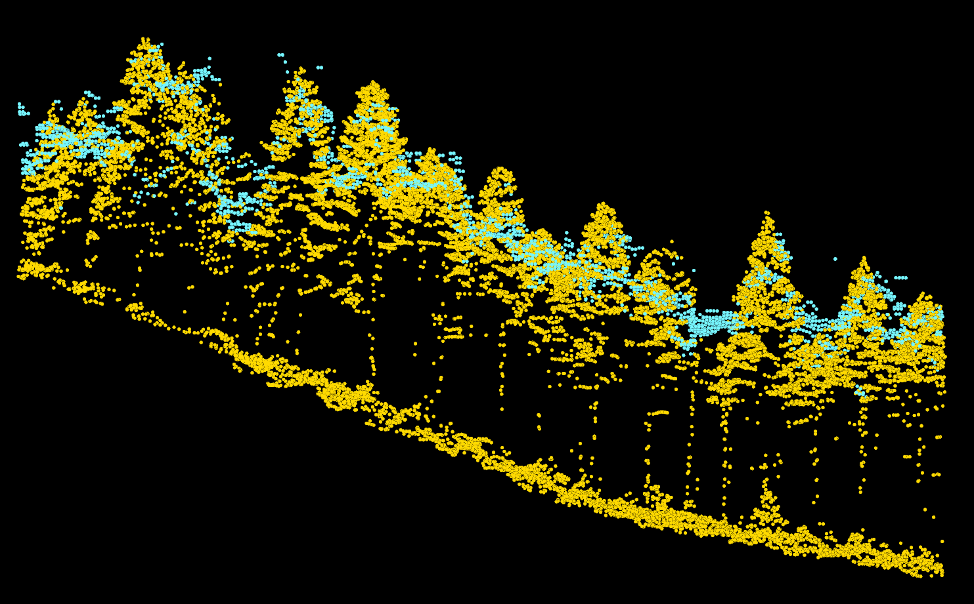
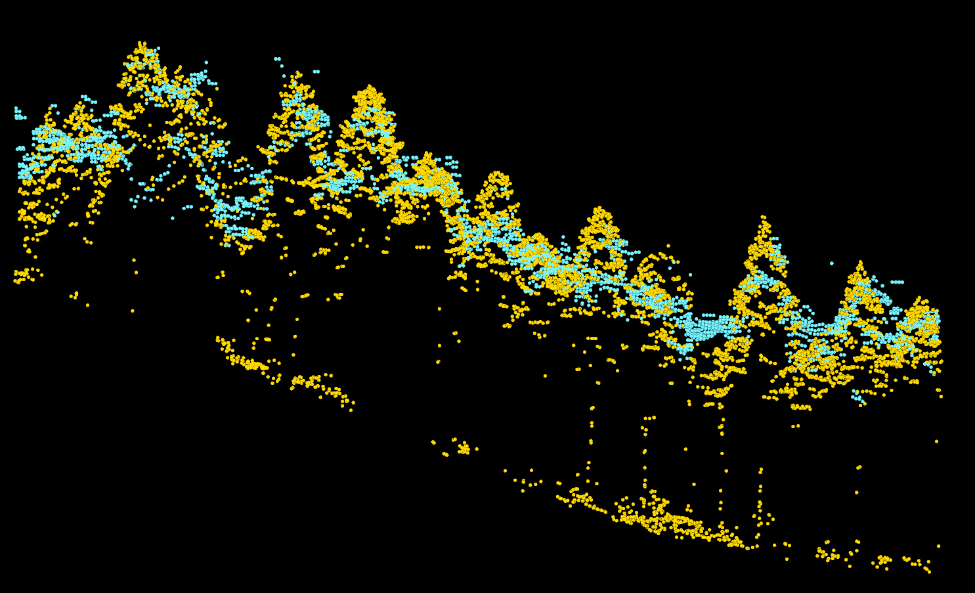
Lidar all returns
Lidar 1st returns only
DAP
lidar

Slide 21
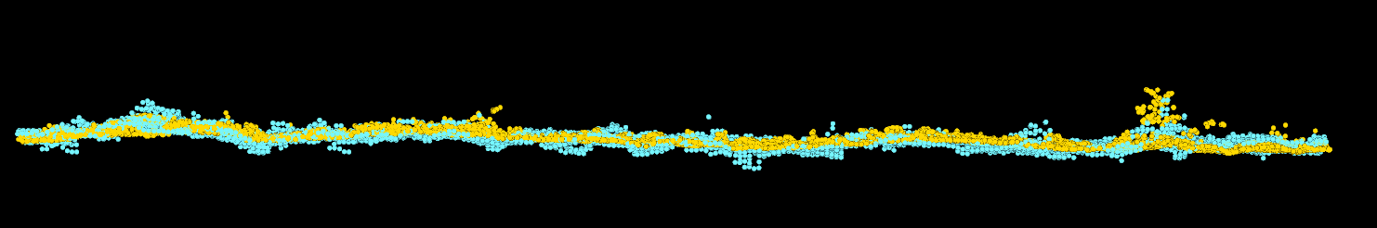
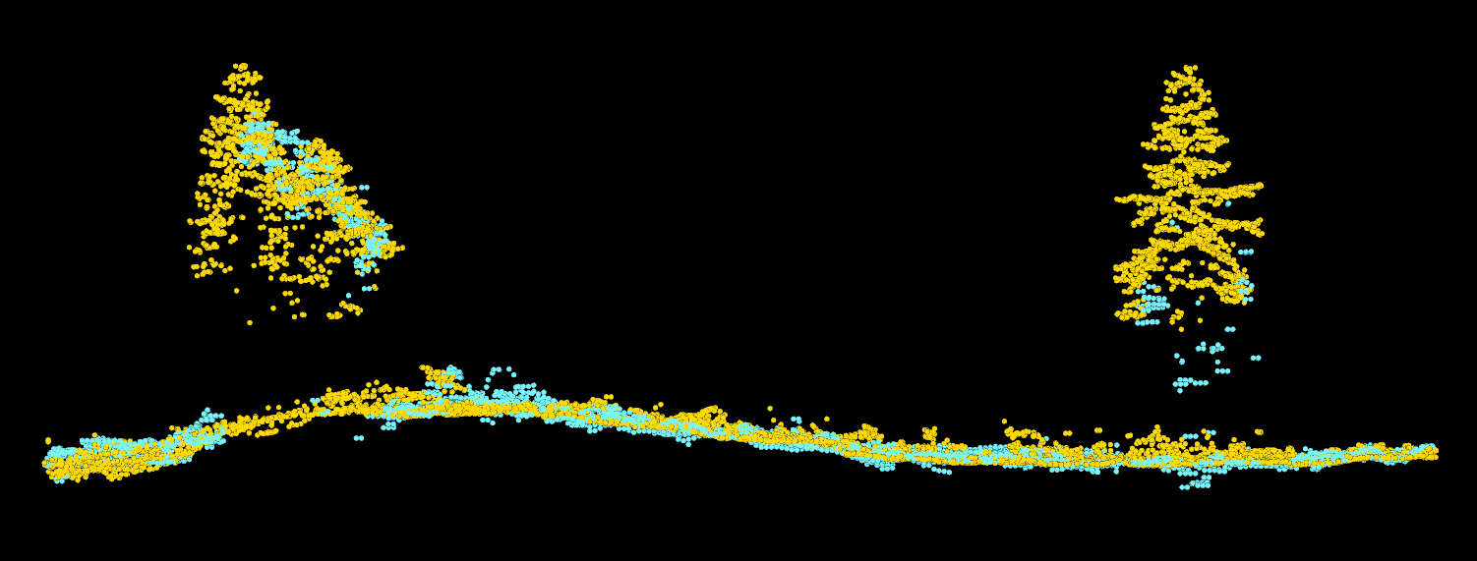
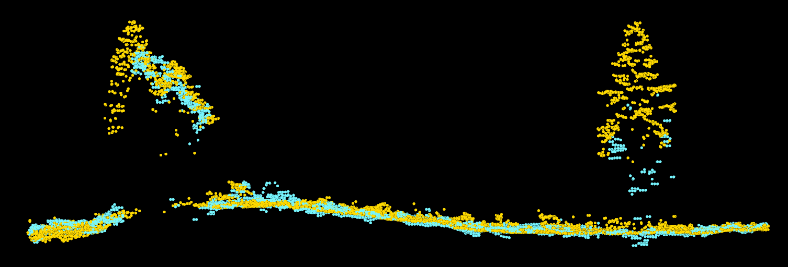
DAP
lidar
Lidar all returns
Lidar 1st returns only

Slide 22
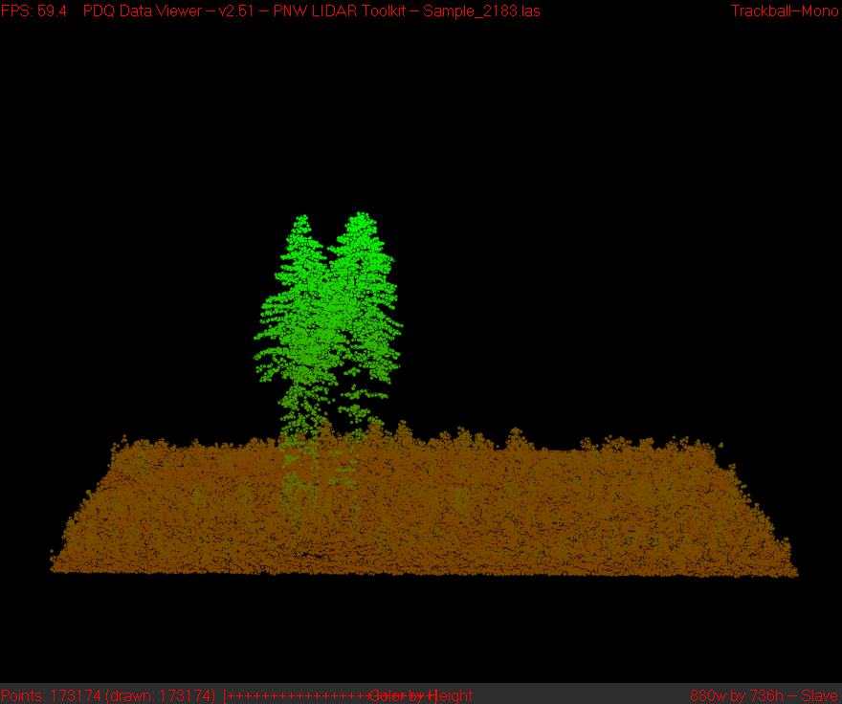
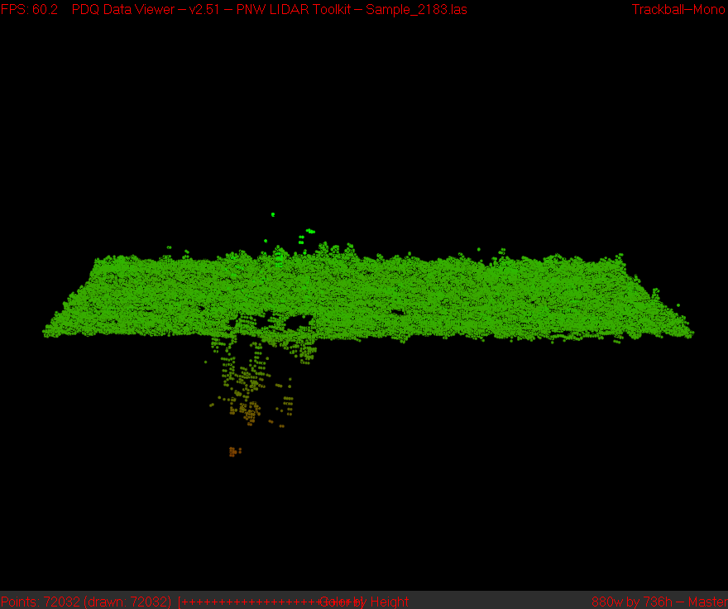
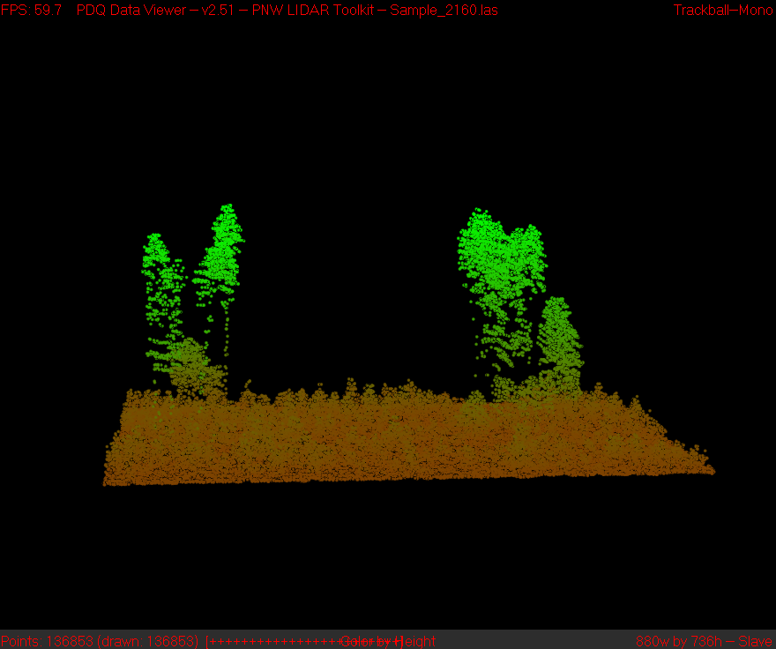
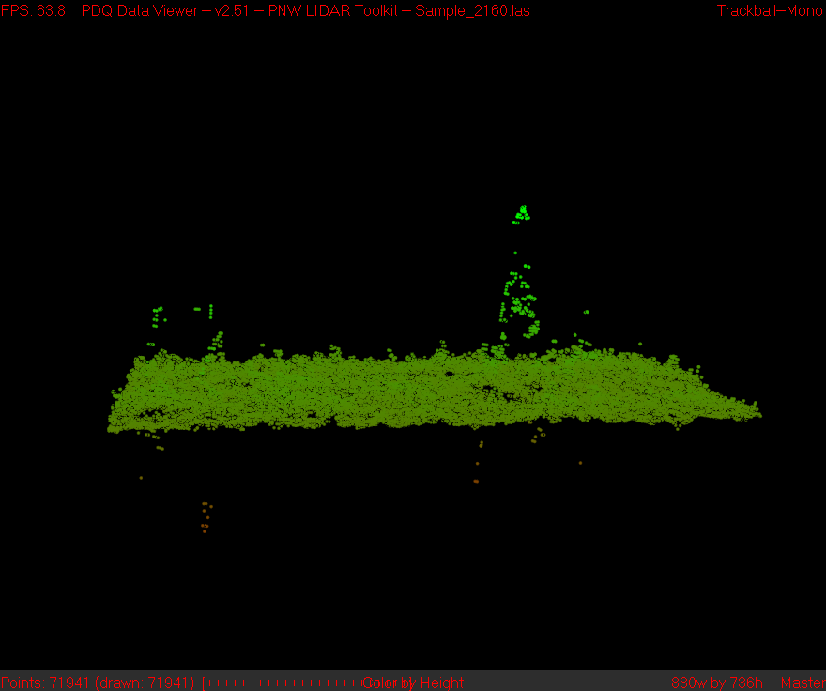
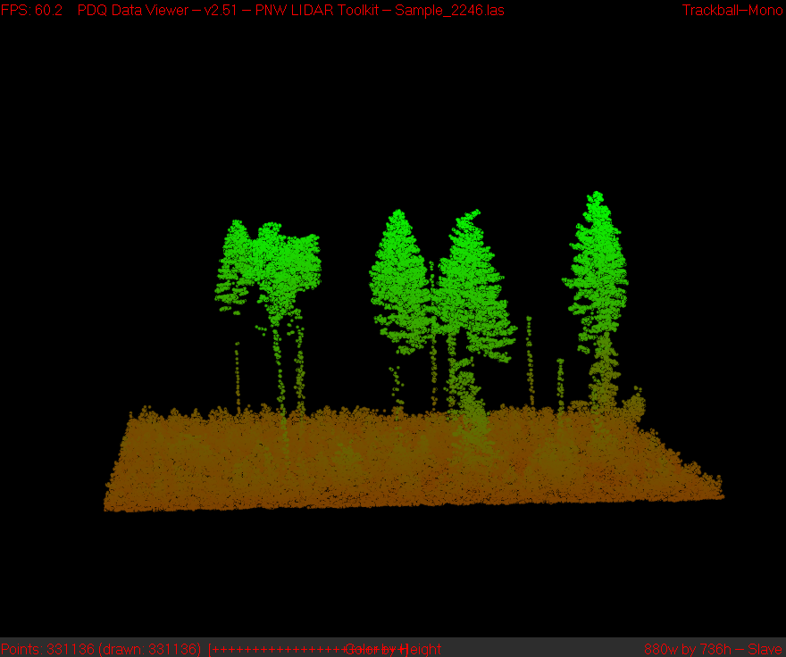
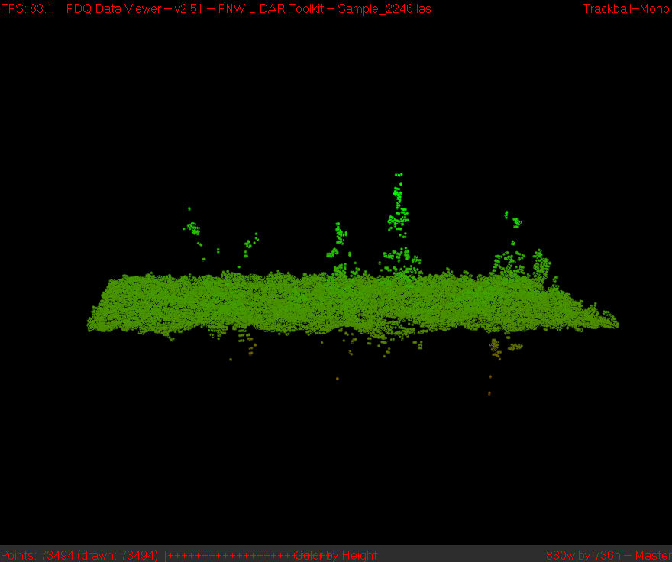
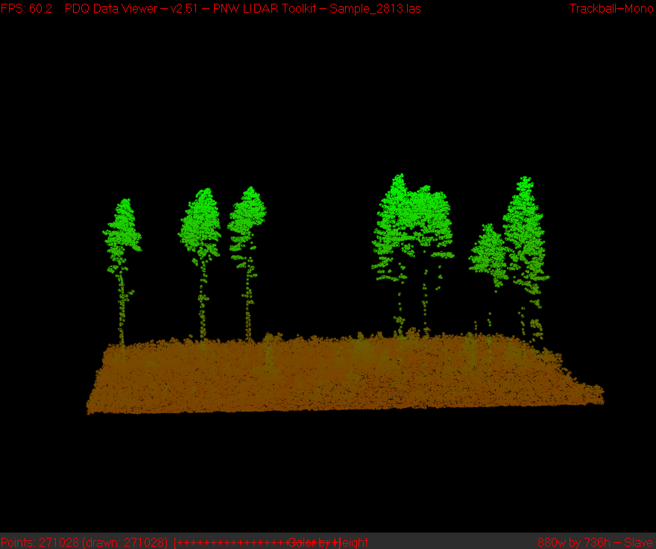
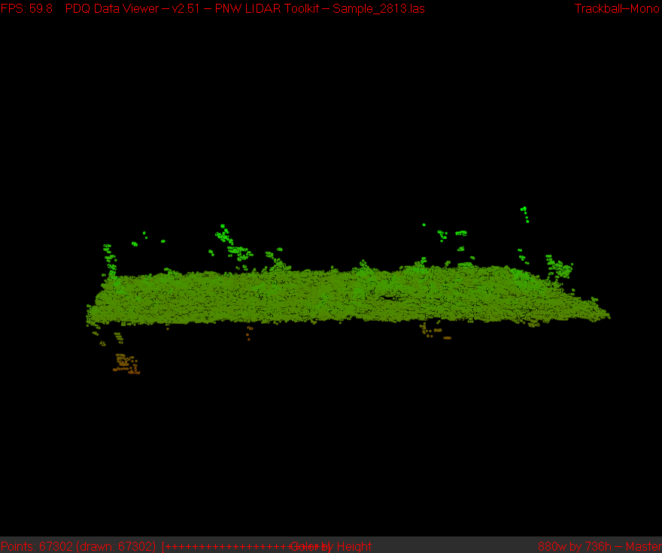
lidar
DAP
lidar
DAP

Slide 23
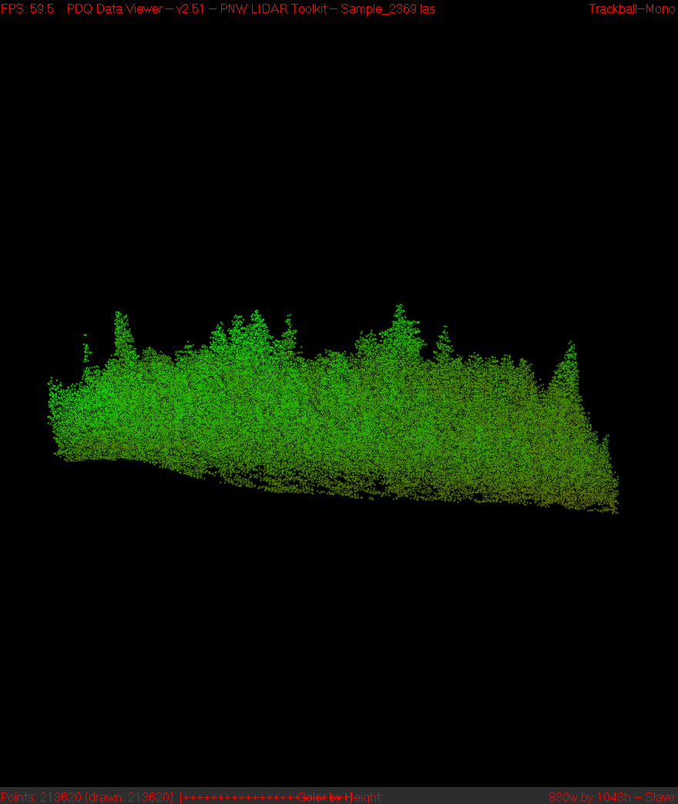
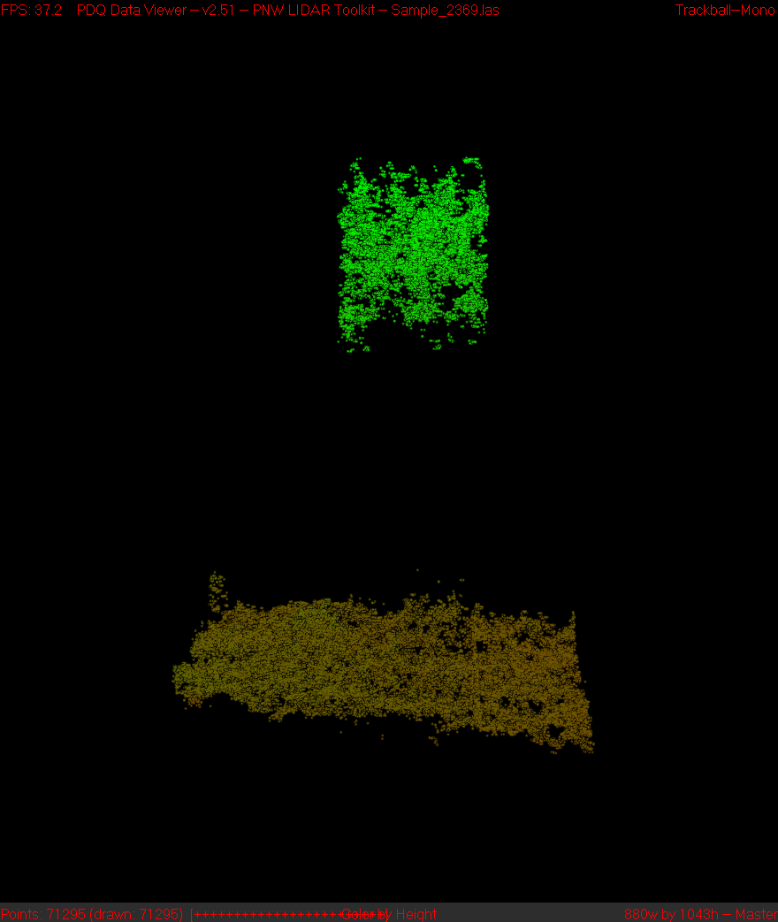
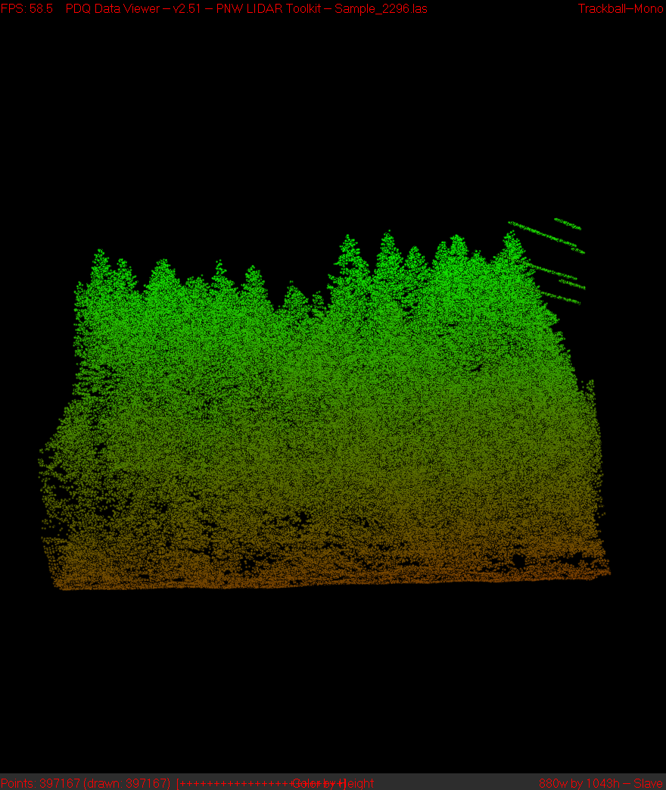
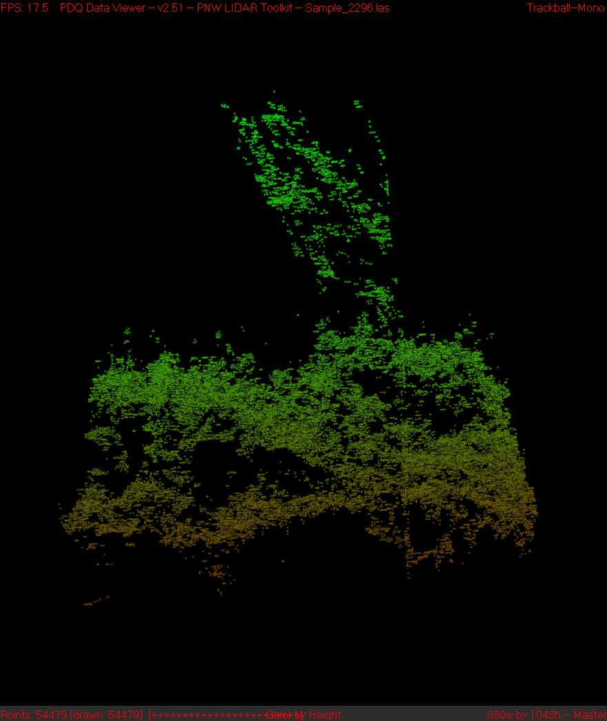
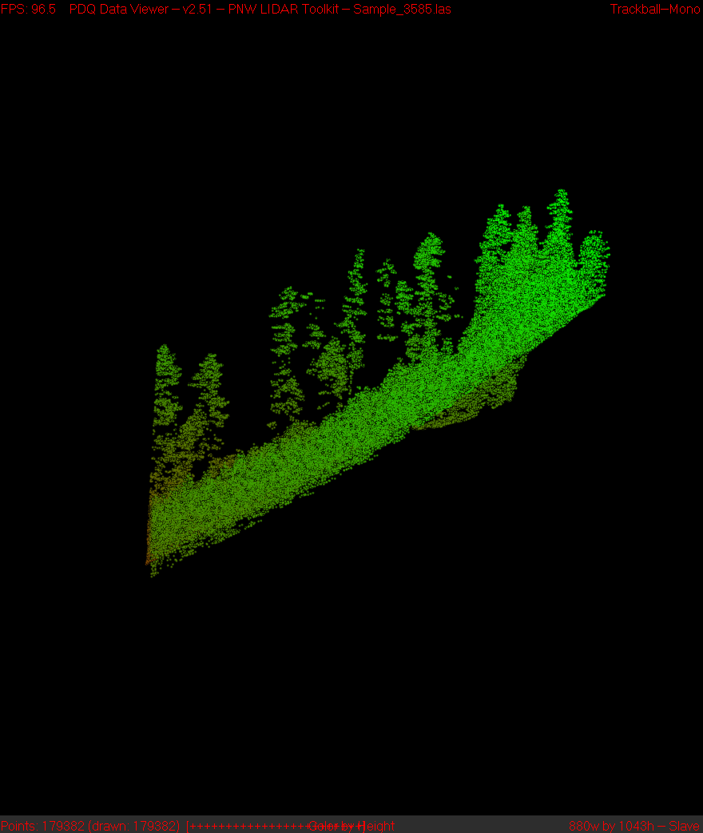
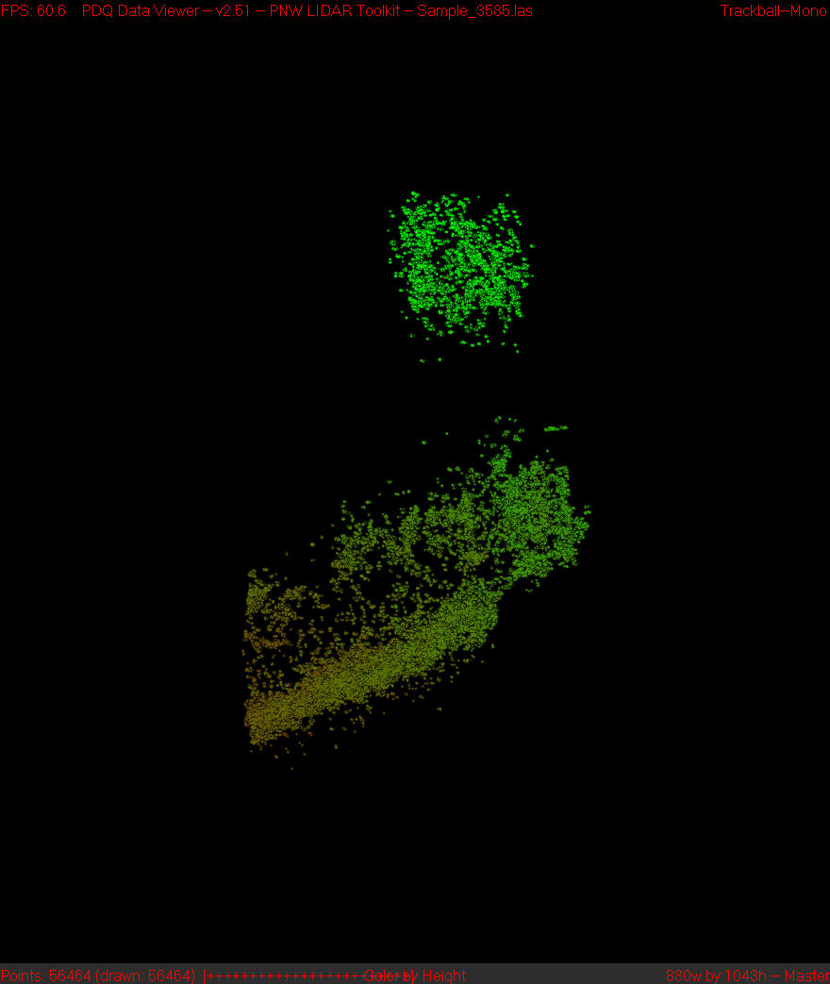
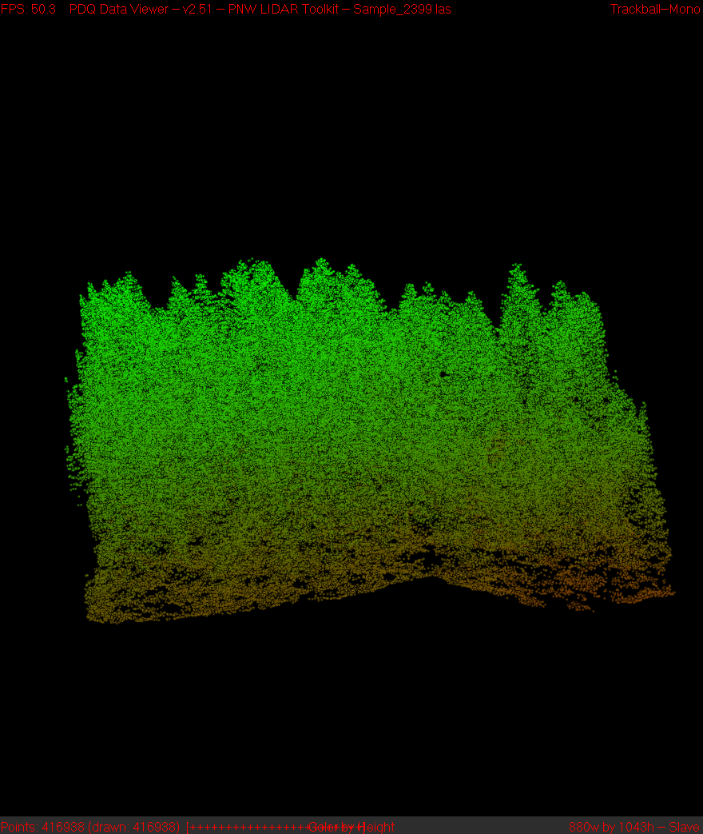
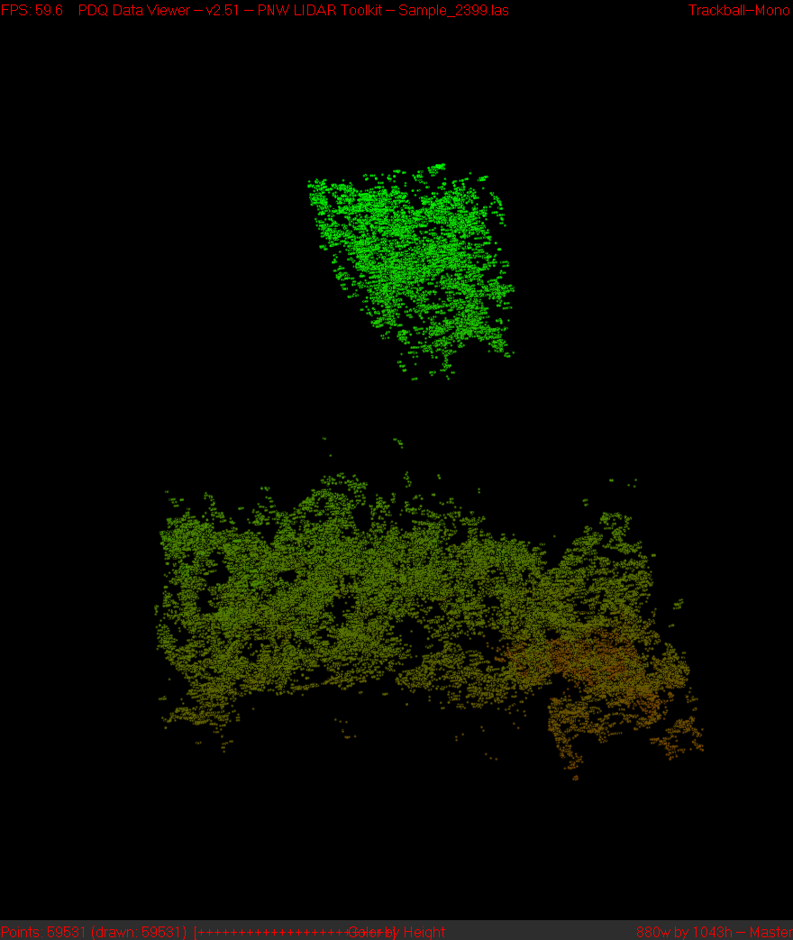
lidar
DAP
lidar
DAP

Slide 24
Conclusions from visual comparison
DAP captures the upper canopy surface and large areas of bare ground
DAP is noisy…lots of anomalies
DAP has problems near water…both open water and water under canopy (riparian areas)
Scattered individual trees are often missed or poorly represented
Small gaps are missed

Slide 25
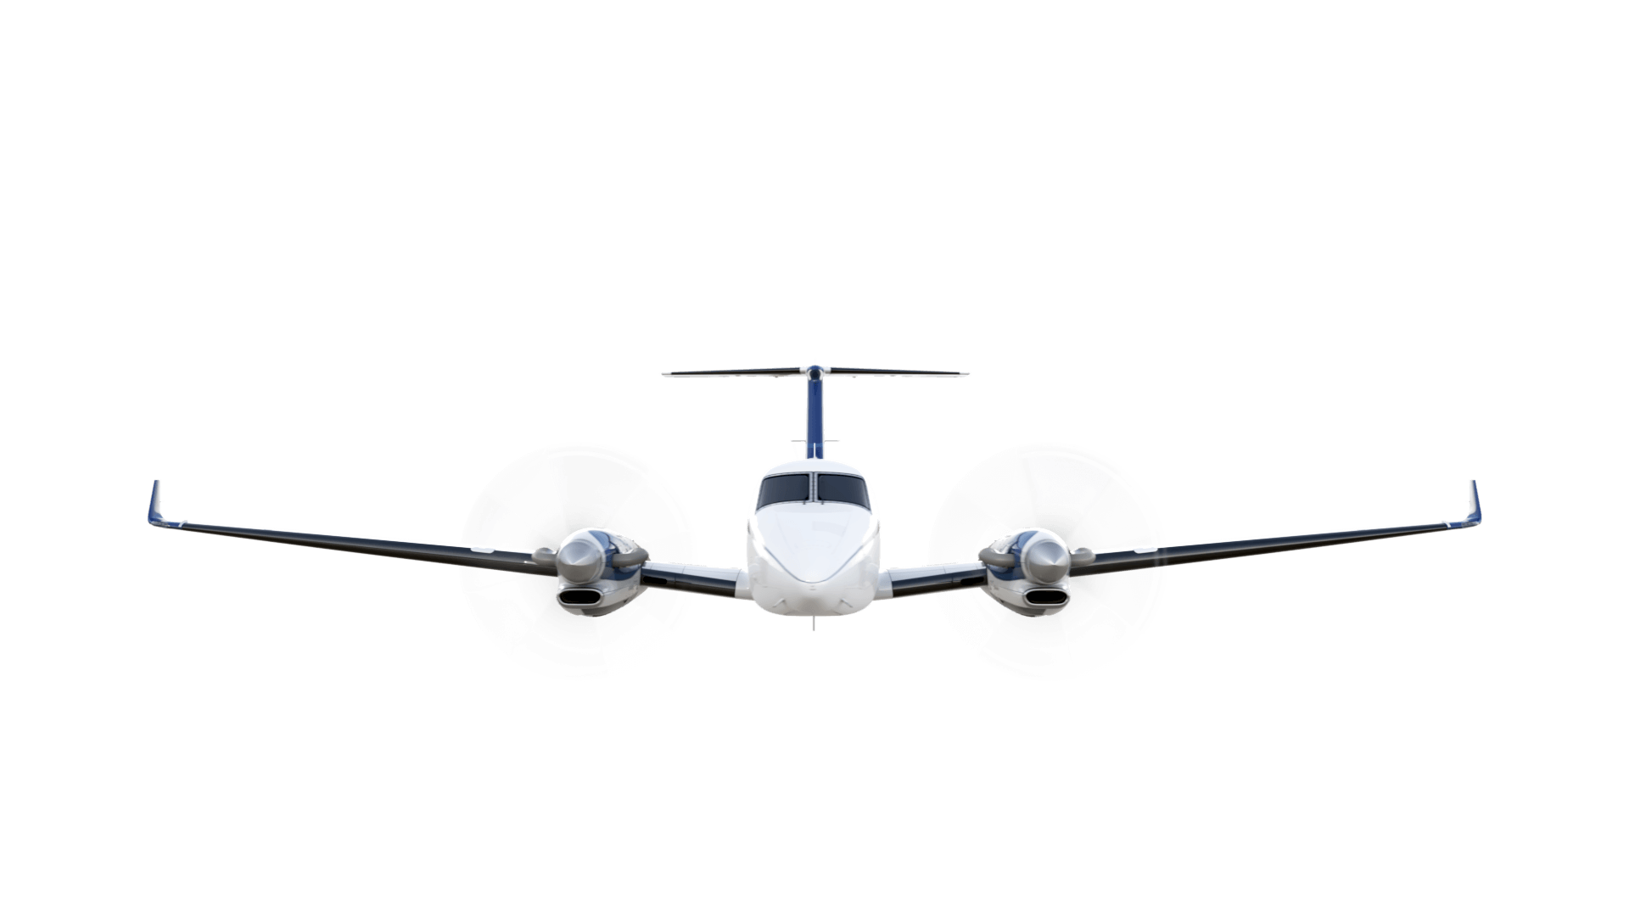

Gap detection
Field-of-view (across track)
Forward look: 65.2°
Nadir look: 77.3°
Backward look: 71.4°
38.65°
-19.4°
150’
53’
120’
53’

Slide 26
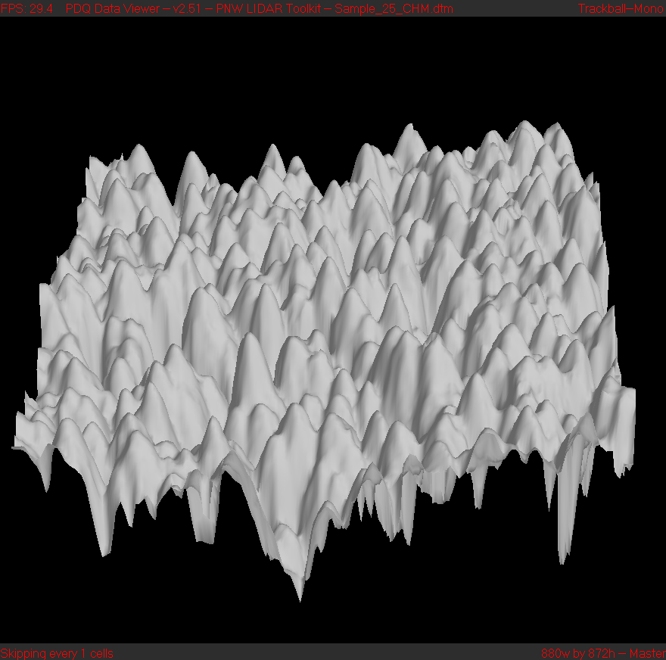
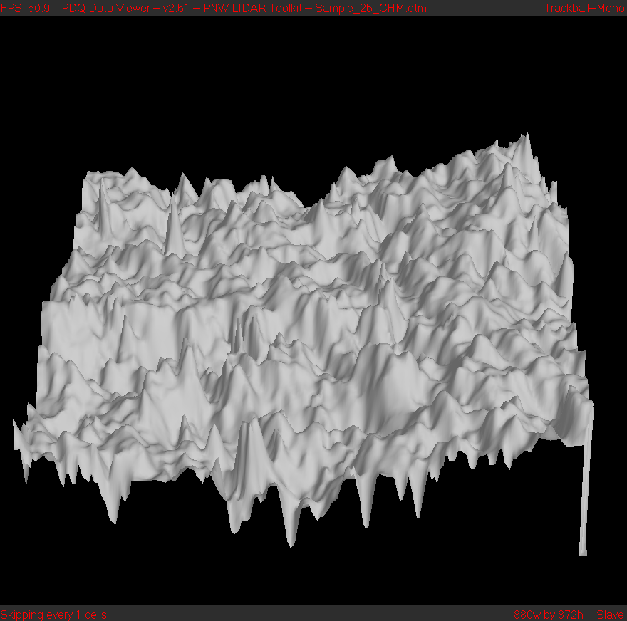
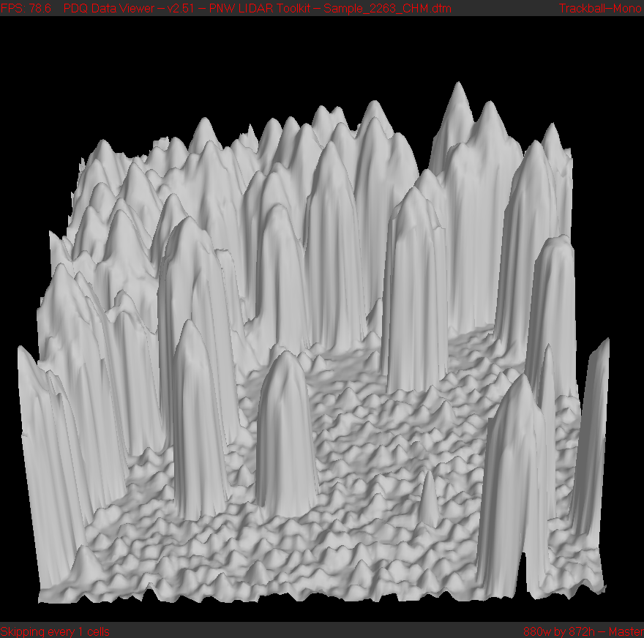
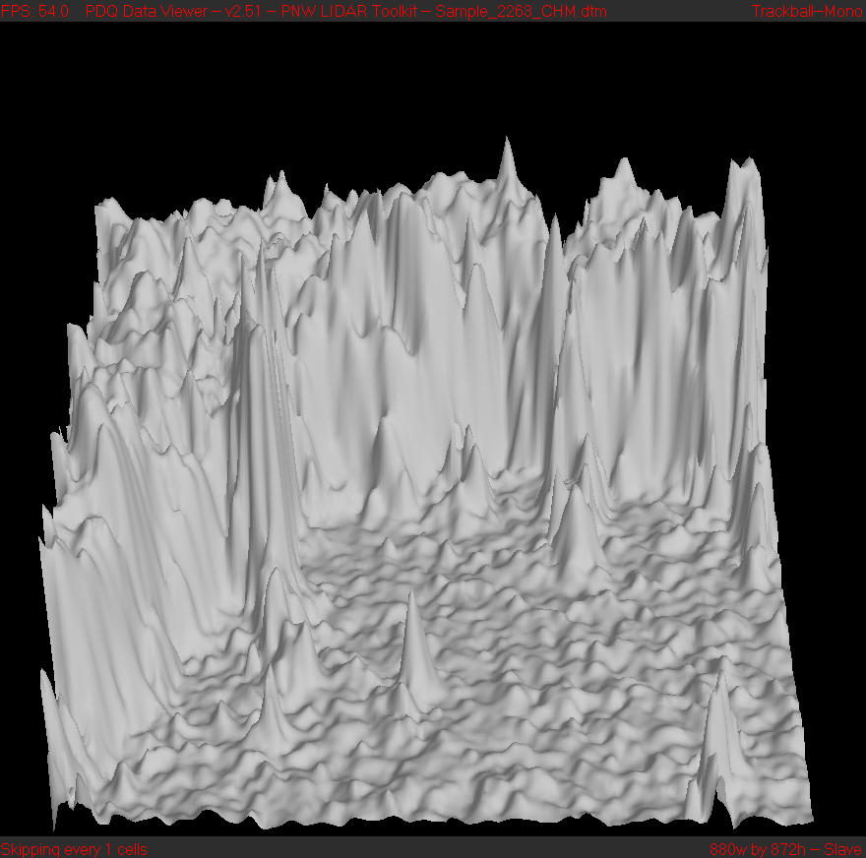
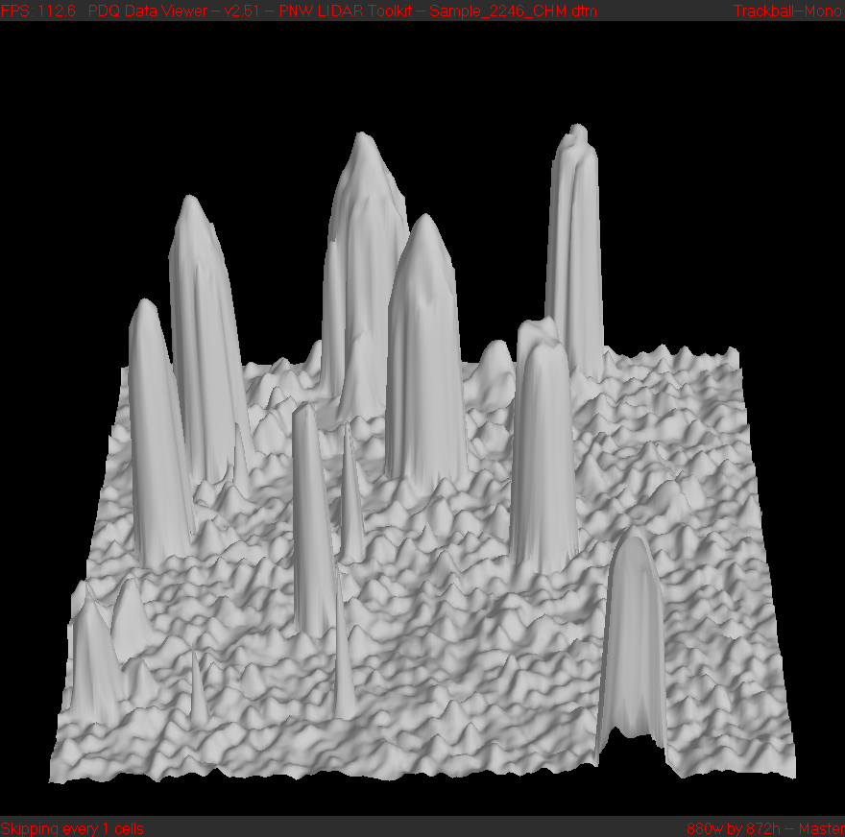
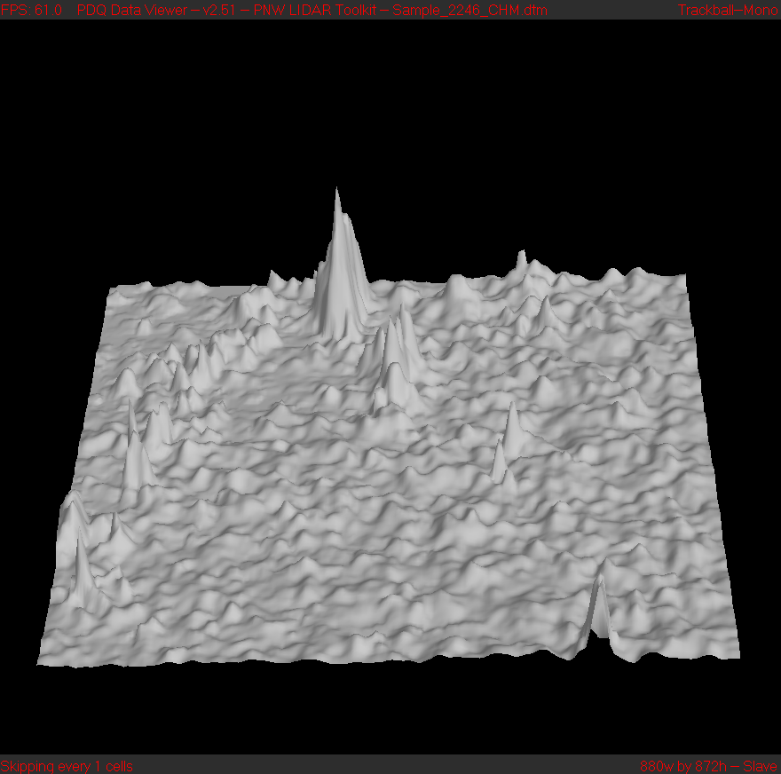
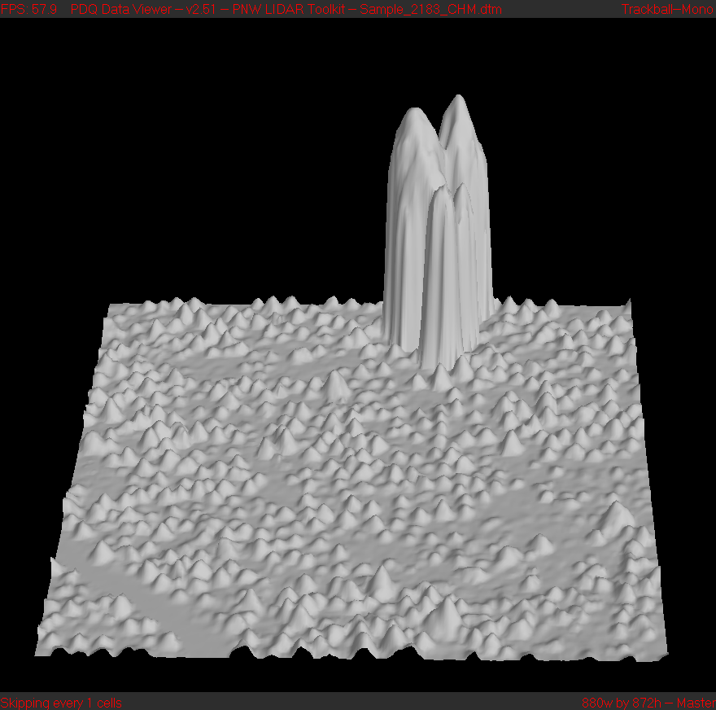
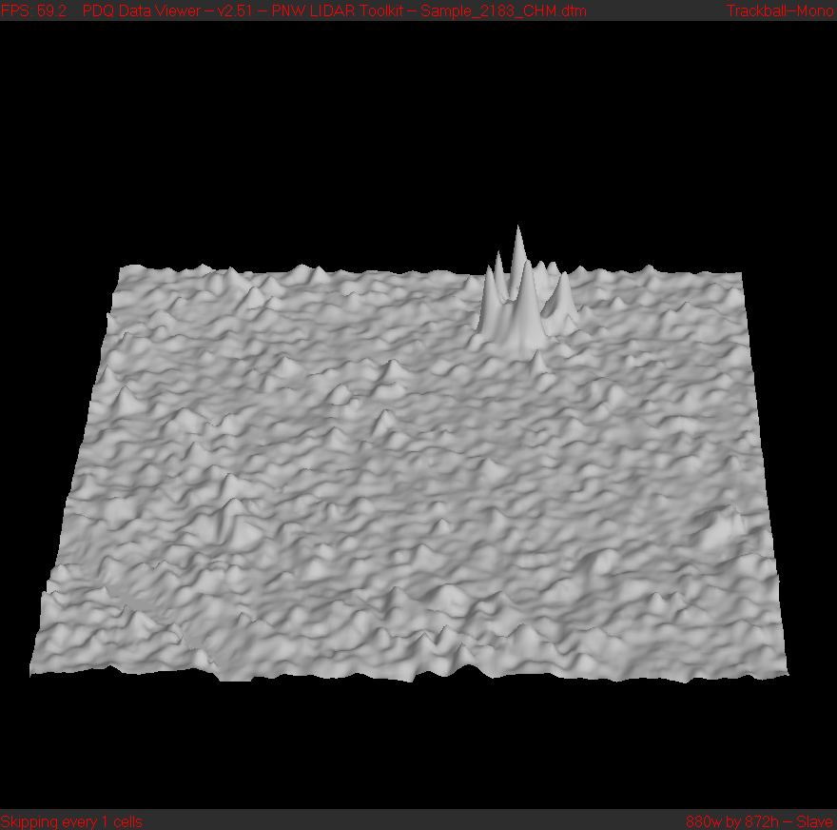
lidar
DAP
lidar
DAP

Slide 27
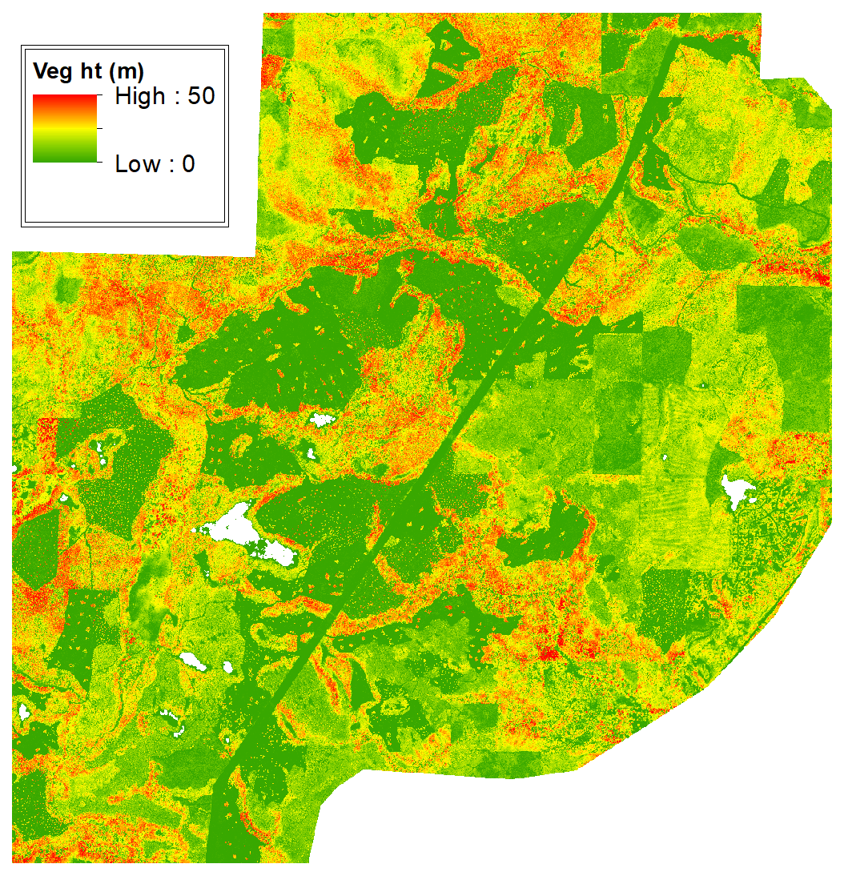
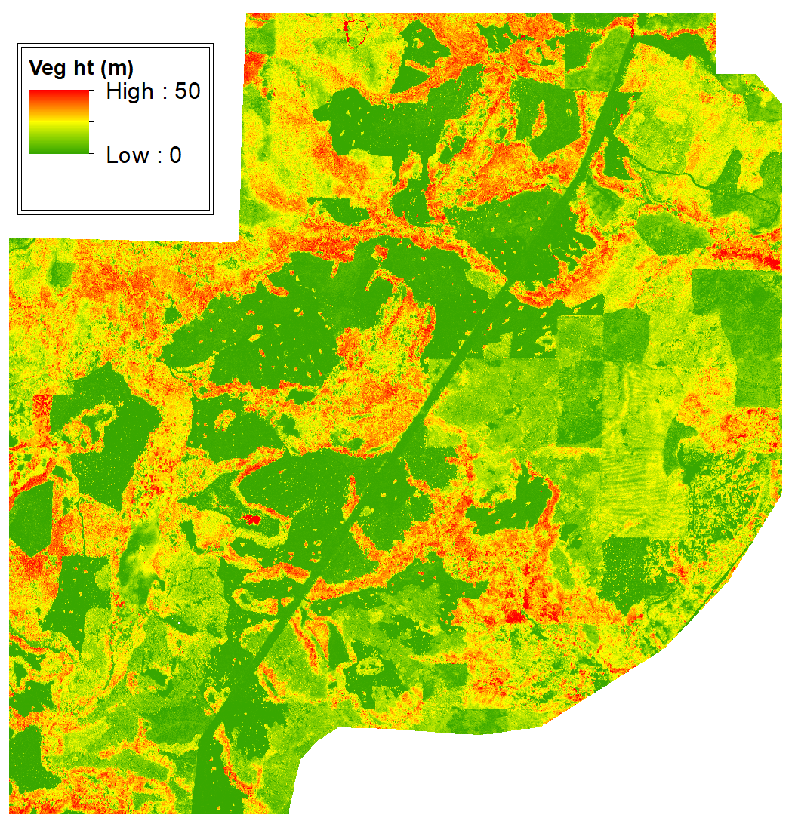
lidar
DAP
Notes:
50m = 164 feet
White areas are either water bodies or areas with no vegetation > 2m tall
Image is 24,000 by 24,000 feet (~4.5 by 4.5 miles)

Slide 28
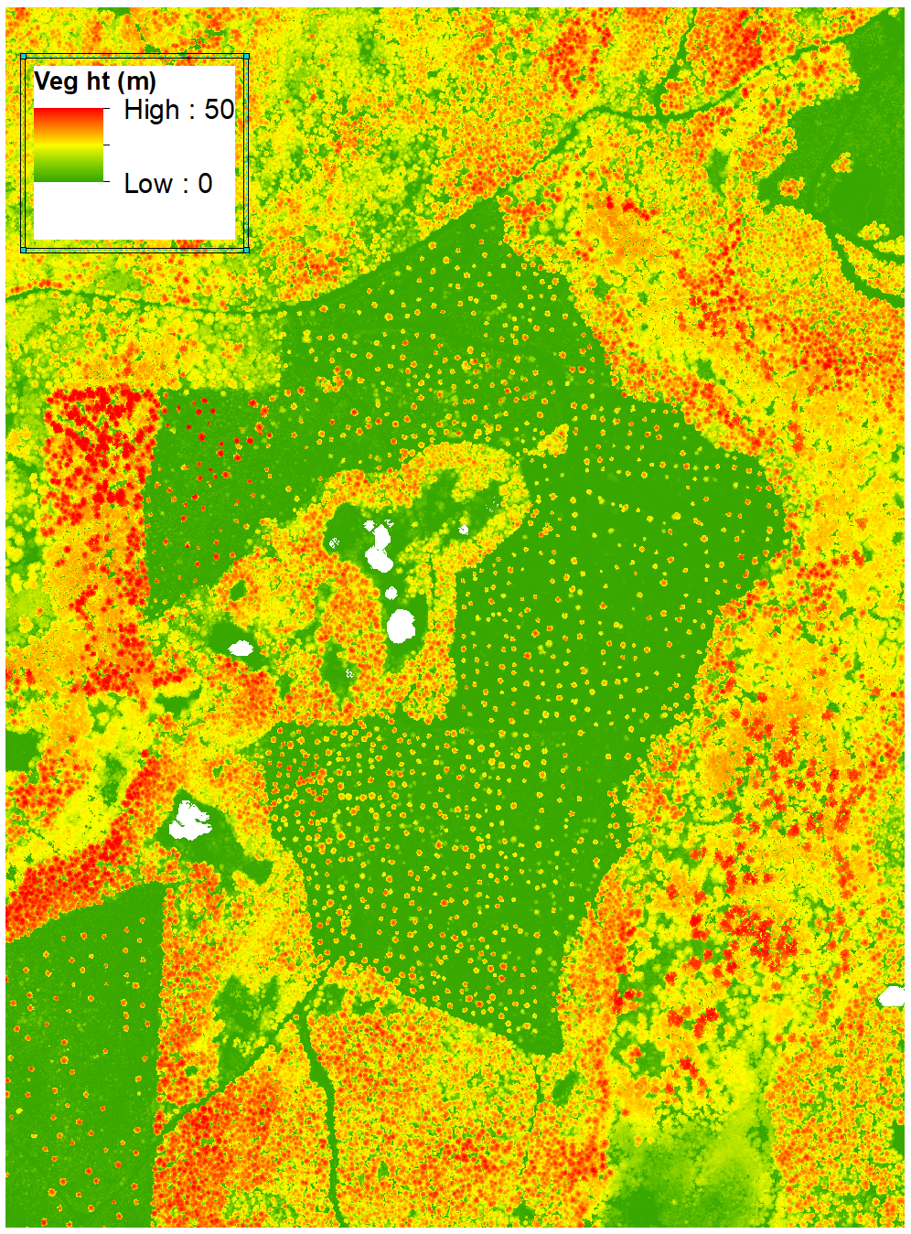
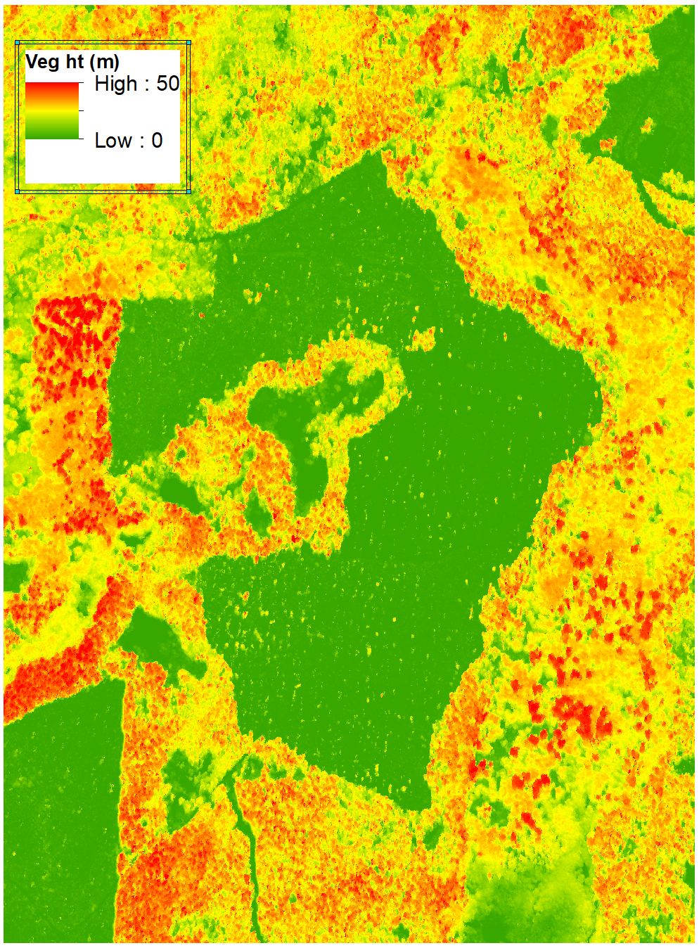
lidar
DAP

Slide 29
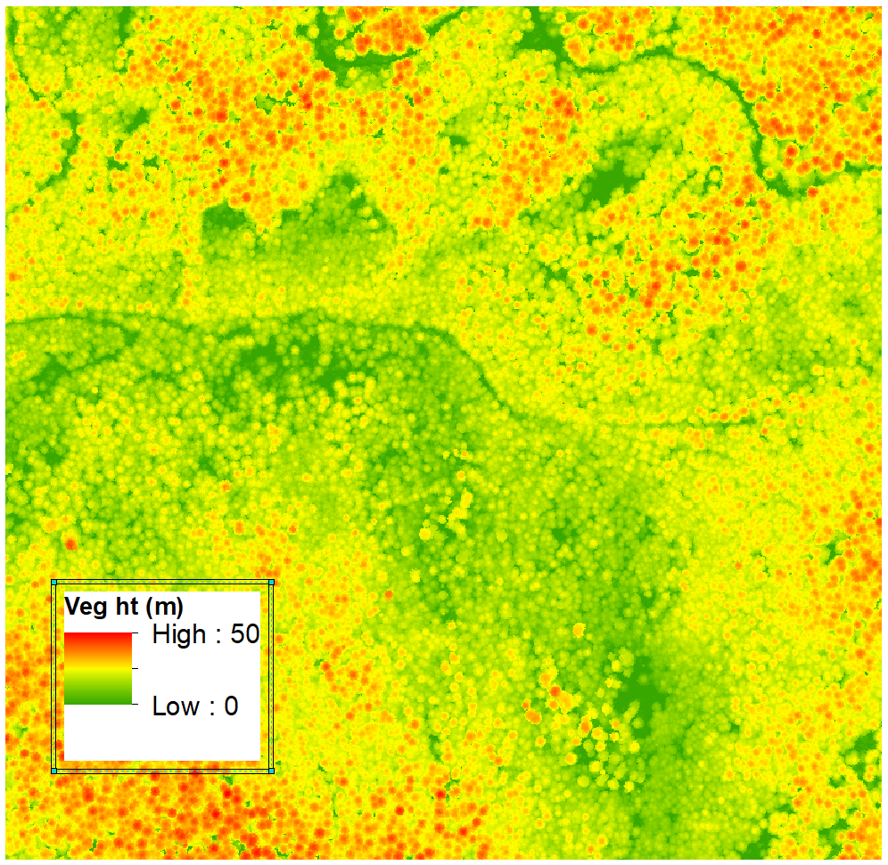
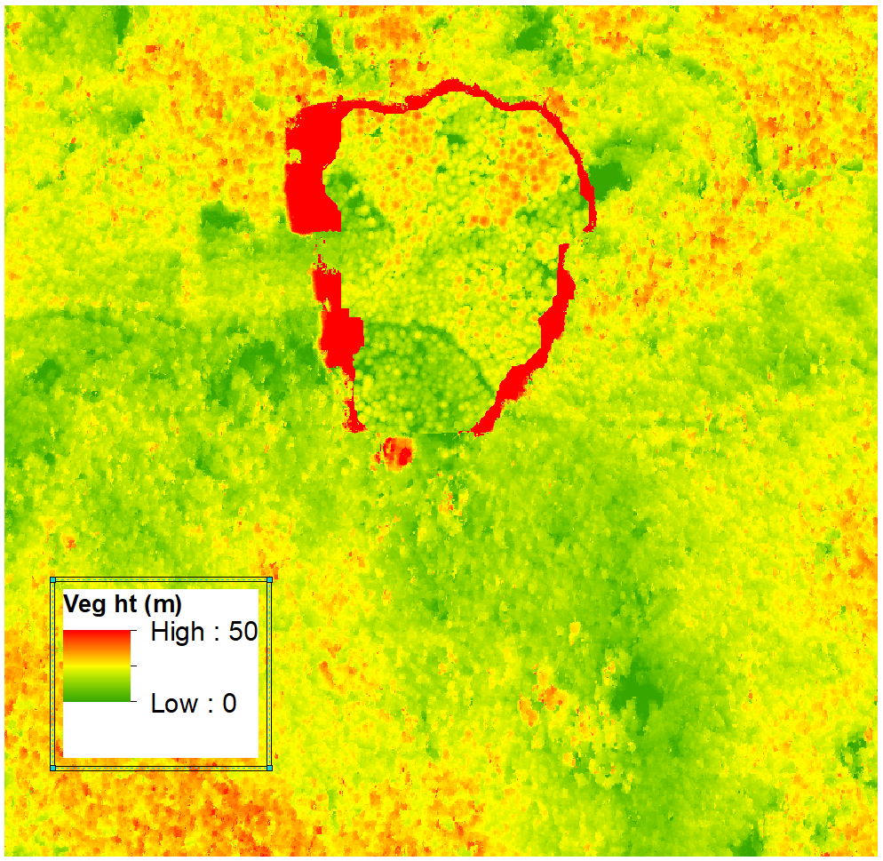
lidar
DAP

Slide 30
Conclusions from CHM comparison
In general, CHMs aren’t bad
Not identical to the lidar CHM
Edges between vegetation types are fairly distinct and sharp
Individual trees are lost or poorly represented
There are blunders in the point data that propagate to the CHMs

Slide 31
Comparison of metrics
3,766 1ha samples clipped from lidar and DAP point clouds
Use lidar bare-ground surface to normalize both data sets
Compare basic metrics from points
Create CHMs and compare metrics derived from CHMs
Stratify samples using canopy cover computed from lidar

Slide 32
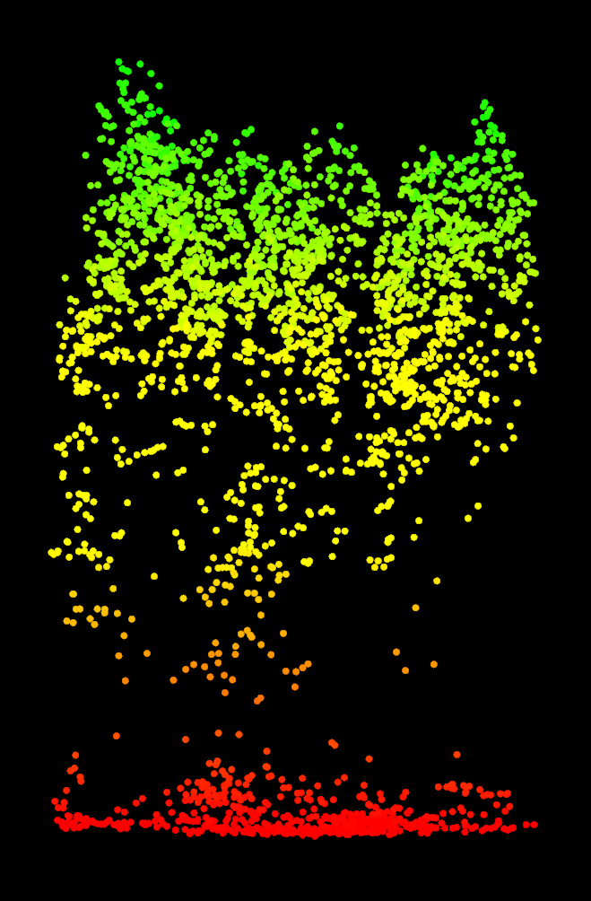

Metrics
Metrics computed using return heights
  Min, Max, Mean
  Median, Mode, Std Dev
  Percentile heights
  Skewness, Kurtosis
  Canopy cover
  Cover above mean
  Cover above mode
CHM metrics:
Volume under surface
rumple (rugosity)
2m
Notes:
To help us identify patterns, we compute a suite of metrics using the point cloud and canopy surface.
These metrics are then subjected to an unsupervised classification approach…

Slide 33
 | Lidar |  | DAP
 | Mean | StdDev | Mean | StdDev
Ave Ht | 63.76 | 25.10 | 64.26 | 29.07
StdDev Ht | 25.46 | 9.27 | 22.17 | 9.49
P10 | 29.77 | 19.93 | 36.07 | 26.28
P25 | 46.81 | 25.82 | 49.31 | 29.60
P50 | 64.79 | 28.94 | 64.36 | 31.87
P80 | 85.23 | 30.90 | 82.45 | 33.75
P95 | 102.88 | 31.63 | 99.18 | 34.58
Cover (%) | 72.60 | 27.33 | 76.01 | 30.55
CHM Rumple | 3.37 | 0.96 | 2.35 | 0.57

Slide 34





Slide 35





Slide 36
Conclusions from metric comparison
Most commonly used metrics agree pretty well
  Upper canopy metrics are better
  Lower canopy is not really represented in DAP
  Agreement is better for higher density forests
DAP point metrics have more noise (higher standard deviation)
CHM metrics reflect overall canopy smoothing

Slide 37
Overall conclusions
Overall, DAP data captures information describing the overstory canopy…limited information for mid- and understory vegetation
Overstory detail is missing…but may not be missed
Overall quality is lower as stand density decreases
Noise is a problem so you have to be careful to use metrics or data products that are not affected by noise or extreme values
Vendors are still figuring out the process
  Data inspection process is more complex and the errors are not the same as we see in lidar data
  It may not be possible to fix some problems easily
You have to have a ground model from another source

